Slide 1
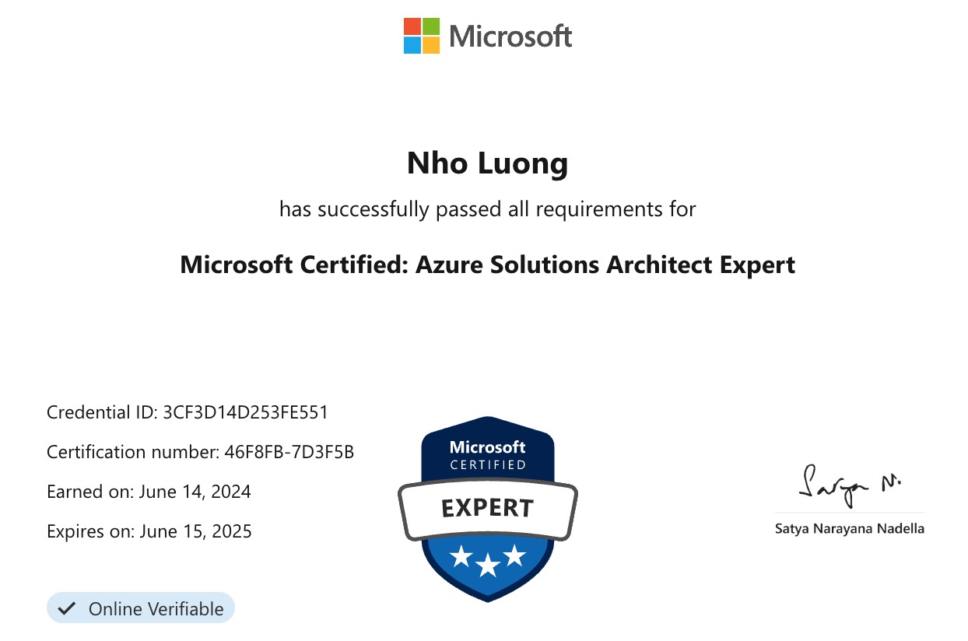

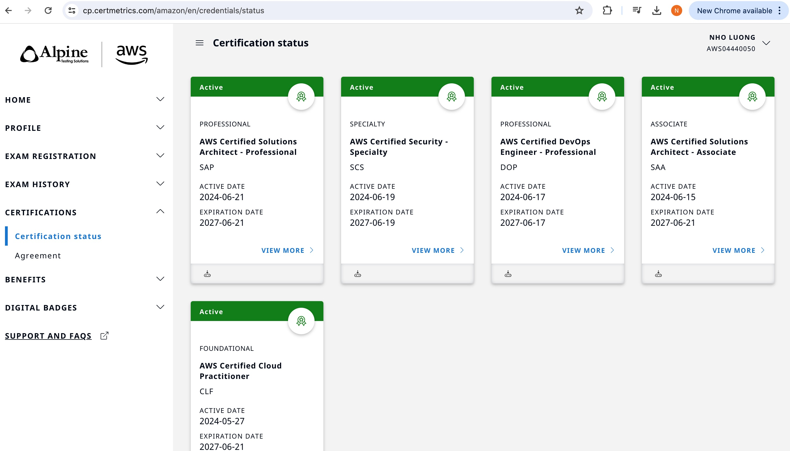
Terraform on Azure Cloud
Author: Nho Luong
Skill: DevOps Engineer Lead

Slide 2
Kubernetes for Beginners On Cloud
STACK
AWS EKS Kubernetes - Masterclass | DevOps, Microservices
Kubernetes
On
Cloud
Roadmap
Azure AKS Kubernetes - Masterclass | DevOps, Terraform
Google GKE Kubernetes - Masterclass | DevOps, Microservices
Docker & Kubernetes for Java Spring Boot Developers on AWS

Slide 3

Kubernetes Concepts
Azure Services Integration with AKS
Azure DevOps
Terraform

Slide 4

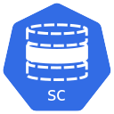

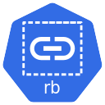
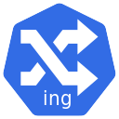
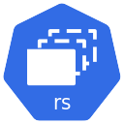
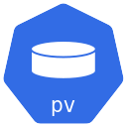


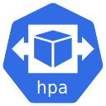

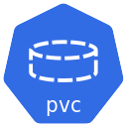

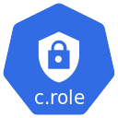

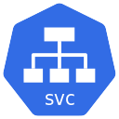

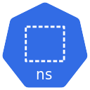
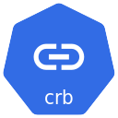
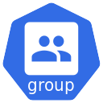
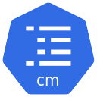
Kubernetes Concepts
Imperative way using kubectl
Declarative way using YAML
Init Containers
Annotations
Ingress SSL with LetsEncrypt
Ingress Context Path based Routing
Ingress Domain Name based Routing
Ingress with External DNS
Virtual Kubelet

Slide 5




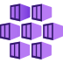




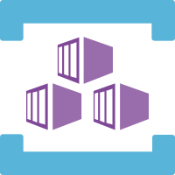





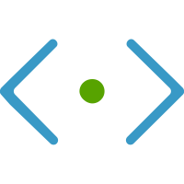

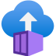

Azure Services Integrated with AKS
Azure
Disks
Azure
Public IP
Azure
AD
Azure
Container
Registry
Azure
Kubernetes
Service
Standard
Load
Balancer
AD
Groups
AKS
Linux & Windows
Nodepools
Azure
MySQL
Azure
DevOps
Azure
Files
Virtual
Network
AD
Users
Azure
Build & Release
Pipelines
Azure
VM
ScaleSets
Azure
DNS
Zones
Azure
Managed
Service
Identity
Storage
Account
Azure
Container Instances
Virtual Nodes
Subnets

Slide 6
Azure DevOps
Terraform
Build and Push Docker Image to ACR
Terraform Command Basics
Deploy to Azure Kubernetes Clusters
Terraform Language Basics
Starter Pipelines
Write from scratch
Provision production grade AKS Cluster using Terraform
Release Pipelines to deploy across Environments (Dev,QA)
Provision AKS Cluster using Terraform & Azure DevOps

Slide 7
GitHub Repositories & Presentation
GitHub Repository Name | GitHub Repository Link
Terraform on Azure AKS Main Repo | https://github.com/nholuongut/azure-aks-kubernetes-masterclass
Automate Azure Private Link using ARM Templates | https://github.com/nholuongut/automate-on-azure-with-private-link-using-arm-templates
Terraform on Azure with IaC DevOps and SRE | https://github.com/nholuongut/terraform-on-azure-cloud
Azure DevOps Demo for the DevOps Lab - Zero to Hero | https://github.com/nholuongut/azure-devops-demo
Microsoft Security DevOps for GitHub Actions Resources | https://github.com/nholuongut/azure-security-devops-action
Azure Stack documentation | https://github.com/nholuongut/azure-stack-docs
Collection of Azure documentation and learning resources | https://github.com/nholuongut/azure-services-learning-resources

Slide 8
Docker - Fundamentals
nginxdemos/hello
Docker Daemon
Docker Registry
(Docker Hub)
nginxdemos/hello
Container-11
Images
Containers
Docker Host
docker pull nginxdemos/hello
Docker Registry or Docker Hub
A Docker registry stores Docker images.
Docker Hub is a public registry that anyone can use, and Docker is configured to look for images on Docker Hub by default.
We can even run our own private registry.
When we use the docker pull or docker run commands, the required images are pulled from our configured registry.
When we use the docker push command, our image is pushed to our configured registry.
docker run -p 82:80 -d nginxdemos/hello
Docker Client (My Desktop or Docker Host)

Slide 9
Kubernetes - Imperative & Declarative
Kubernetes Fundamentals
Imperative
Declarative
kubectl
YAML & kubectl
Pod
Pod
ReplicaSet
ReplicaSet
Deployment
Deployment
Service
Service

Slide 10

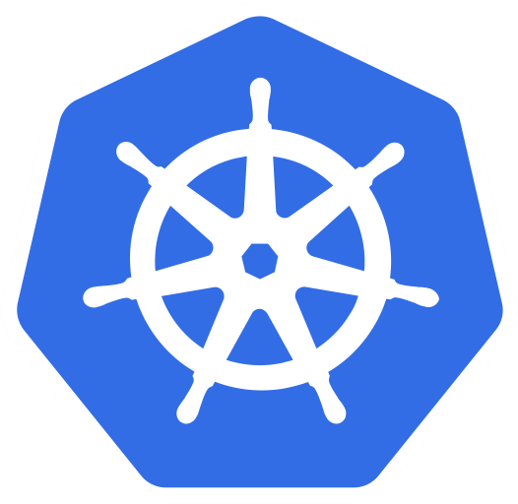
Azure AKS Cluster
http://<External-IP-from-get-service-output>
UserMgmt – LoadBalancer Service
Users
Load Balancer Service
Deployment
Web
App
Environment Variables
POD
ReplicaSet
Init Containers
Azure Disks
Deployment (UserMgmt)
MySQL – ClusterIP Service
Config Map
Storage Class
Environment Variables
Persistent Volume Claim
Volumes
MySql
AKS Storage Azure Disks
Persistent Volumes
Volume Mounts
POD
ReplicaSet
Deployment
Deployment (mysql)
ClusterIP Service

Slide 11
Azure AKS Cluster
http://<External-IP-from-get-service-output>
UserMgmt – LoadBalancer Service
Users
Load Balancer Service
Deployment
Web
App
Environment Variables
POD
ReplicaSet
Init Containers
Deployment (UserMgmt)
MySQL – ExternalName Service
High Availability
Monitoring & Alerting
AKS Storage Azure MySQL Database
Backup & Recovery
Automatic Upgrades
Read Replicas
Azure MySQL
Database
Secure Data at rest and motion

Slide 12
http://<External-IP-from-get-service-output>/app1/file1.html
Azure AKS Cluster
LoadBalancer Service
Users
Load Balancer Service
AKS Storage Azure Files
Deployment
NGINX
NGINX
NGINX
POD
POD
POD
Volumes
ReplicaSet
Deployment
Volume Mounts
Storage Class
Key Advantage with Azure File Shares:
Multiple pods can access the single file share
Azure Storage Account
Persistent Volume Claim
file1.html
file2.html
Persistent Volumes
</>
HTML
</>
HTML
Azure File Shares

Slide 13





Azure AKS & Nginx Ingress – Context Path Based Routing
Azure
Azure AKS Cluster
Nginx App1
/app1/
/app2/
/
Ingress Service
Nginx App2
Users
Public IP
for Ingress
Controller
Ingress Controller
AKS
Load Balancer
Usermgmt WebApp

Slide 14


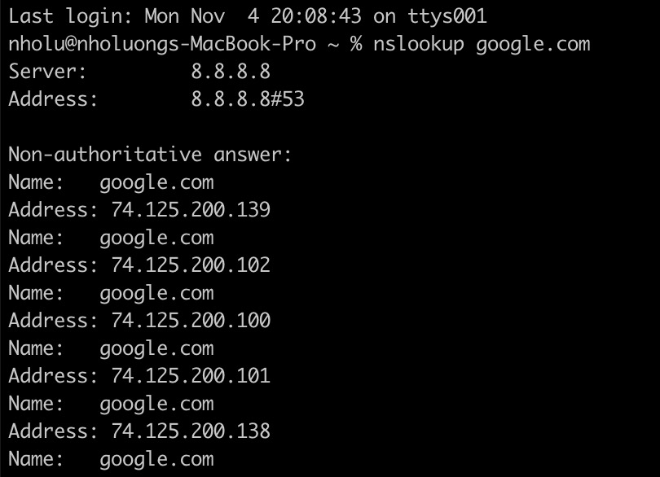
Delegate Domain to Azure DNS
AWS Cloud
Azure Cloud
DNZ Zones
Domain Registrar
google.com
google.com
AWS Route53
Azure DNS Zones

Slide 15
Azure AKS Nginx Ingress Hostname based Routing External DNS
Azure
Azure AKS Cluster
Virtual Machine
Scale Sets
DNS
Zones
Managed
Service
Identity
Nginx App1
External DNS
eapp1.kubeoncloud.com
eapp2.kubeoncloud.com
eapp3.kubeoncloud.com
Nginx App2
Ingress Service
Users
Public IP
for Ingress
Controller
Ingress Controller
AKS
Load Balancer
Usermgmt WebApp

Slide 16

Azure AKS Nginx Ingress External DNS SSL with Lets Encrypt
Azure
Azure AKS Cluster
Virtual Machine
Scale Sets
External DNS
DNS
Zones
Managed
Service
Identity
cert-manager
sapp1.kubeoncloud.com
sapp2.kubeoncloud.com
Nginx App1
Ingress Service
Users
Public IP
for Ingress
Controller
Ingress Controller
AKS
Load Balancer
Nginx App2

Slide 17
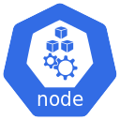

Kubernetes – Requests & Limits
K8s cluster
K8s Node
default namespace
CPU: 8 vcores
(8000m)
Container-1
Container-2
Memory: 32GB
CPU: 500m
CPU: 1000m
CPU: 500m
CPU: 1000m
Mem: 128Mi
Mem: 500Mi
Mem: 128Mi
Mem: 500Mi
Requests
Limits
Requests
Limits

Slide 18
Kubernetes - Namespaces & DNS
K8s cluster
K8s Node
default namespace
dev namespace
qa namespace
App1
App1
App1
app1.default.svc.cluster.local
app1.dev.svc.cluster.local
app1.qa.svc.cluster.local
<service-name>.<namespace-name>.svc.cluster.local

Slide 19
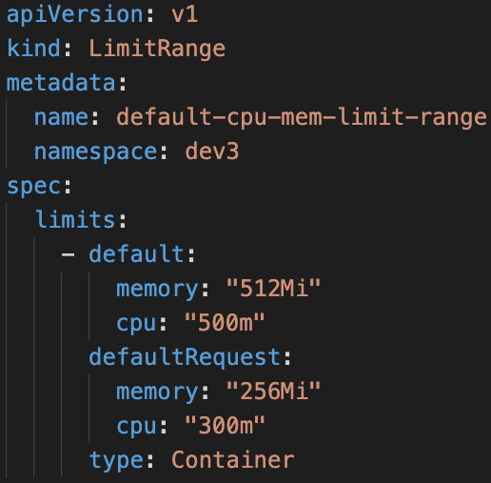
Limit Range
LoadBalancer Service
LoadBalancer Service
LoadBalancer Service
F
F
F
Pod
Pod
Pod
Limit Range Manifest
ReplicaSet
ReplicaSet
ReplicaSet
Deployment
Deployment
Deployment
ClusterIP Service
ClusterIP Service
ClusterIP Service
B
B
B
Pod
Pod
Pod
ReplicaSet
ReplicaSet
ReplicaSet
Deployment
Deployment
Deployment
Deployment
CPU
Memory
CPU
Memory
CPU
Memory
default
Min/Max
default
Min/Max
default
Min/Max
Limit Range (Per Container)
Limit Range (Per Container)
Limit Range (Per Container)
Namespace: dev
Namespace: qa
Namespace: staging

Slide 20
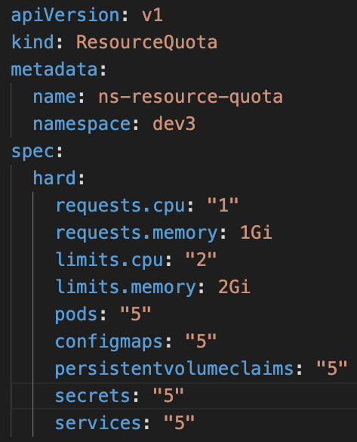
Resource Quota
LoadBalancer Service
LoadBalancer Service
LoadBalancer Service
F
F
F
Resource Quota Manifest
Pod
Pod
Pod
ReplicaSet
ReplicaSet
ReplicaSet
Deployment
Deployment
Deployment
ClusterIP Service
ClusterIP Service
ClusterIP Service
B
B
B
Pod
Pod
Pod
ReplicaSet
ReplicaSet
ReplicaSet
Deployment
Deployment
Deployment
Deployment
CPU
Memory
CPU
Memory
CPU
Memory
Pods
Services
Pods
Services
Pods
Services
Resource Quota
Resource Quota
Resource Quota
Namespace: dev
Namespace: qa
Namespace: staging

Slide 21
Azure AKS Virtual Nodes
Virtual Kubelet
Azure Container Instances
ACI
Azure Virtual Nodes on
AKS
+
=

Slide 22
Azure AKS - Virtual Nodes
Azure Cloud
Azure AKS Cluster
VNET1
AKS Cluster
Control Plane
Node Pool
Virtual Nodes
Azure Container Instance - ACI
Subnet: default
Subnet: virtual-node-aci

Slide 23




Azure AKS - Virtual Nodes Mixed Mode Deployments
Azure Cloud
Azure AKS Cluster
VNET1
MySQL Cluster IP Service
UserMgmt LoadBalancer Service
MySQL Pod
Usermgmt Pod
Virtual Node
AKS Worker Node
Node Pool
Azure Container Instance - ACI
Subnet: default
AKS Cluster
Control Plane
Subnet: virtual-node-aci
Azure Disks

Slide 24

Azure ACR and AKS - Integration
Docker Developer
Azure Cloud
Azure Container
Registry
Azure AKS Cluster
Build and Push
Docker Image
Integrate ACR and AKS
Azure AKS Cluster
Control Plane
Pull Docker Image from ACR
http://<public-ip>
Users
Public IP
App1 LB
Nginx App1
AKS
Load Balancer

Slide 25
Pull Docker Images from ACR using Service Principal
Run on Azure AKS Nodepools
Docker Developer
Azure Cloud
Azure Container
Registry
Azure AKS Cluster
Build and Push
Docker Image
Azure AKS Cluster
Control Plane
Pull Docker Image from ACR
docker-server
docker-username
http://<public-ip>
docker-password
Users
Public IP
App1 LB
Nginx App1
AKS
Load Balancer

Slide 26
Pull Docker Images from ACR using Service Principal
Run on Azure Virtual Nodes
Docker Developer
Azure Cloud
Azure Container
Registry
Azure AKS Cluster
Azure AKS Cluster
Control Plane
Build and Push
Docker Image
Pull Docker Image from ACR
docker-server
docker-username
docker-password
http://<public-ip>
Nginx App1
Users
Public IP
App1 LB
Virtual Node - ACI
AKS
Load Balancer

Slide 27
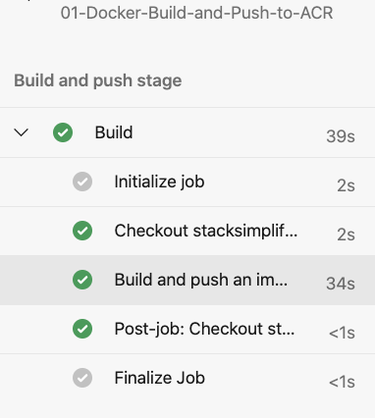
Azure DevOps Pipelines – Build & Push Docker Image to ACR
Azure Cloud
Azure DevOps
Github
Azure Pipelines
(Build & Push)
Azure Container Registry
Developer

Slide 28
Azure DevOps – Build & Push Docker Image to ACR & Deploy to AKS
Azure DevOps
Azure Cloud
Developer
Azure Pipelines
1
2
Stage-1: Build & Push to ACR
4
Stage-2: Deploy to AKS
Github
5
Azure AKS Cluster
3
default namespace
Nginx App1
6
Azure Container Registry

Slide 29
Azure Pipelines – Key Concepts
Pipeline
Stages
Steps
Trigger
Stage-1: Build
Agent
Step-1: script: echo Hello, world!
Job
Stage-2: AA
Step-2: Task-1: Docker Build & Push to ACR
Github
Agent
Stage-3: BB
Job
Step-3: Task-2: Copy Files to Build Artifact Directory
Stage-4: CC
Job
Step-4: Task-3: Publish Artifacts to Azure Pipelines
Developer

Slide 30
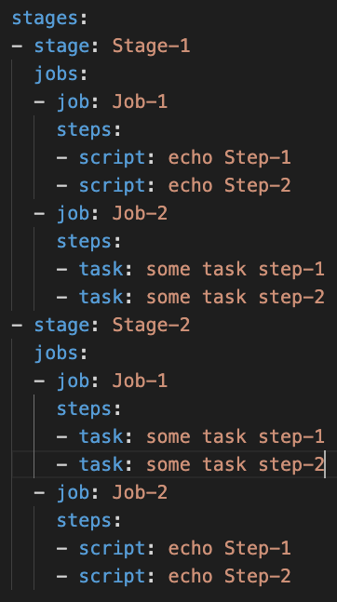
Azure Pipelines – Key Concepts
Stages
Stage-1
Jobs
Job-1
Steps
Step-1: Script
Step-2: Task
Job-2
Steps
Step-1: Task
Step-2: Task
Stage-2
Jobs
Job-1
Steps
Step-1: Script
Step-2: Script
Job-2
Steps
Step-1: Task
Step-2: Task

Slide 31
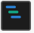
Azure Pipelines – Starter Pipeline
Goal
Create a Pipeline that will build docker images, push them to Azure Container Registry and Publish Kubernetes Manifests to Azure Pipelines
Part-1
Semi Customized
Part-2
Fully Customized using Starter Pipeline
Task-1
Use pre-defined Docker Build & Push Pipeline
Task-1
Start using Starter pipeline and use Docker Build or Push Docker Images Task
Task-2
Customize Pipeline to Use Copy Files Task
Task-2
Customize Pipeline to Use Copy Files Task
Task-3
Customize Pipeline to Use Publish Build Artifacts Task
Task-3
Customize Pipeline to Use Publish Build Artifacts Task

Slide 32
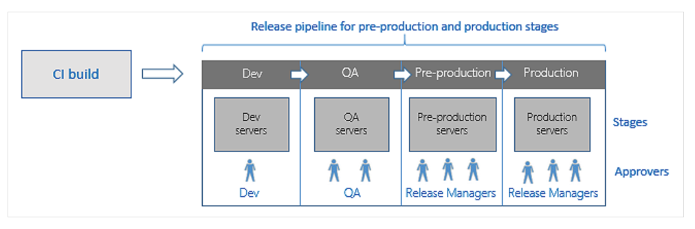
Azure DevOps – Release Pipelines
To achieve Continuous Delivery we use Release Pipelines

Slide 33
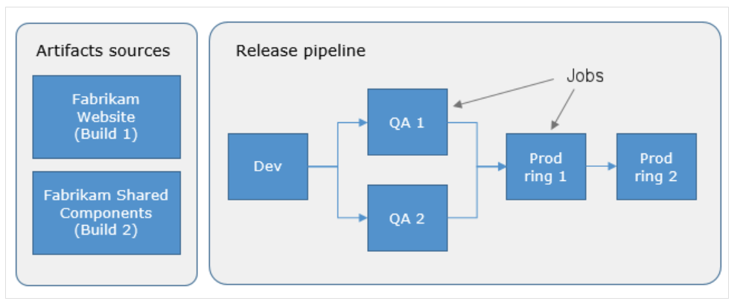
Azure DevOps – Release Pipelines

Slide 34



Developer
Github
Azure DevOps – Release Pipelines
1
2
Azure Cloud
Azure DevOps
Release Pipelines
QA
Azure Pipelines
7
Stage-1: Build & Push to ACR
4
Dev
Staging
12
Prod
3
10
Azure Container Registry
6
5
9
8
Azure AKS Cluster
12
11
14
13
dev namespace
qa namespace
Staging namespace
prod namespace
Nginx App1
Nginx App1
Nginx App1
Nginx App1

Slide 35
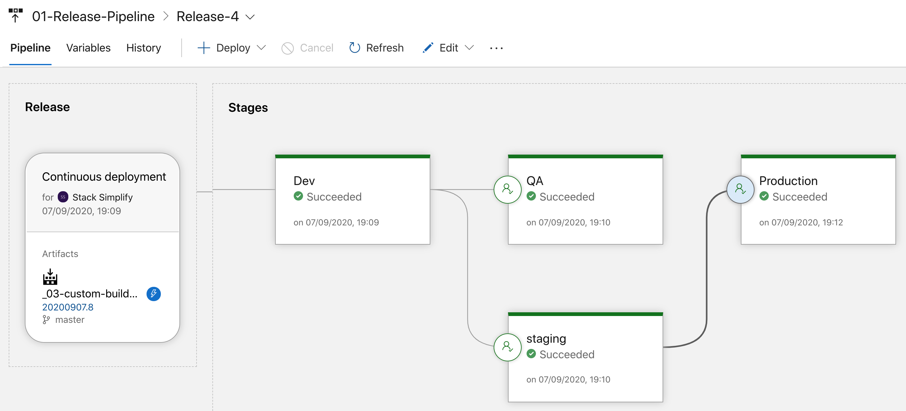
Azure Release Pipelines

Slide 36
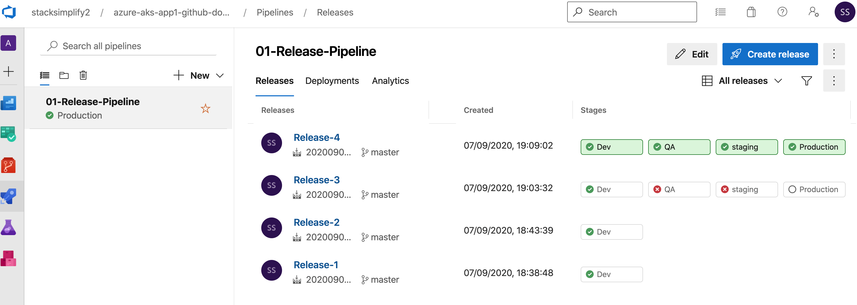
Azure Release Pipelines - Releases

Slide 37
Azure AKS HTTP Application Routing Add On Ingress + External DNS (Automatic Install)
Azure Cloud
Azure AKS Cluster
app1.7b8803340f38495c8402.centralus.aksapp.io
7b8803340f38495c8402.centralus.aksapp.io
DNS Zones
Nginx App1
External DNS
app1.7b8803340f38495c8402.centralus.aksapp.io
app1.7b8803340f38495c8402.centralus.aksapp.io
Users
Public IP
for Ingress
Controller
Ingress Controller
Ingress Service
AKS
Load Balancer
HTTP Application Routing Add On

Slide 38
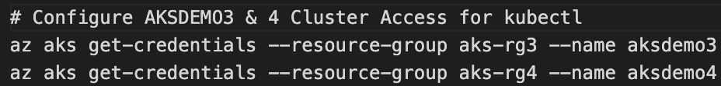
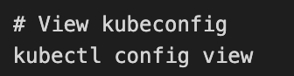

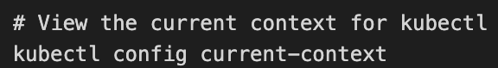
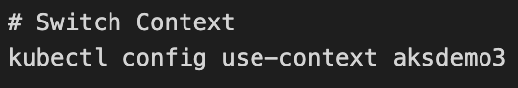
Azure AKS Cluster Access
AKS Cluster - 1
AKS Cluster-1
kubectl
Current Context
AKS Admin
AKS Cluster-2
AKS Cluster - 2

Slide 39


Azure Active Directory Authentication for AKS Admins
Integrate Azure AD and AKS Cluster
Azure Active Directory
Azure AKS Cluster
Azure AD Group: k8sadmins
Your Desktop
kubectl
K8S API Server
Azure AD User: user1aksadmin
Terminal

Slide 40

Azure Active Directory Authentication for AKS Admins
Authentication
Your Desktop
Azure AKS Cluster
Terminal
2
Browser
1
kubectl get nodes
Azure Active Directory
4
3
Credentials Cached
Azure AD User: user1aksadmin
K8S API Server
Azure AD Group: k8sadmins

Slide 41
Kubernetes RBAC
Kubernetes RBAC - Fundamentals
Subjects
API Groups
Resources
Verbs
Users or processes that need access to the Kubernetes API
The k8s API objects that we grant access to
List of actions that can be taken on a resource
Kind: Group, User
core
Pods
Create
Patch
Kind: Service Account
extensions
Deployments
List
get
apps
Services
Watch
Replace
batch
StatefulSets
Delete
Read
Reference: https://kubernetes.io/docs/reference/generated/kubernetes-api/v1.19

Slide 42

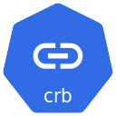
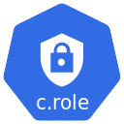
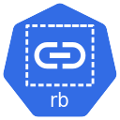

Kubernetes RBAC
Kubernetes Cluster RBAC
Cluster Role Binding
Cluster Role
Namespace: DEV
Namespace: QA
User / Group
(Subject)
Create
(Verb)
Role Binding
Role Binding
Role
Role
User / Group
(Subject)
Create
(Verb)
Pod
(Resource)
User / Group
(Subject)
Create
(Verb)
Pod
(Resource)

Slide 43
Azure Active Directory & Kubernetes RBAC
Azure AKS Kubernetes Cluster
Namespace: DEV
Namespace: QA
Role Binding
Role Binding
Role
Role
User / Group
(Subject)
Create
(Verb)
Pod
(Resource)
User / Group
(Subject)
Create
(Verb)
Pod
(Resource)
Azure AD Group: devaksteam
Azure AD User: aksdev1
Azure Active Directory
Object ID: e6dcdae4-e9ff-4261-81e6-0d08537c4cf8

Slide 44
Azure Active Directory & Kubernetes RBAC
Authentication
k8s Role
k8s Role Binding
Azure AKS Kubernetes Cluster
Namespace: DEV
Role Binding
Azure Active Directory
Role
Integrate Azure AD Group & Kubernetes RBAC
User / Group
(Subject)
get
(Verb)
Pod
(Resource)
Azure AD Group: devaksteam
Credentials Cached
5
Object ID: e6dcdae4-e9ff-42
61-81e6-0d08537c4cf8
3
Access
Granted
kubectl get pods -n dev
4
2
1
Azure AD User: aksdev1
Terminal
Your Desktop

Slide 45
Azure Active Directory & Kubernetes RBAC
Authentication
Azure AKS Kubernetes Cluster
k8s Role
k8s Role Binding
Namespace: DEV
Role Binding
Azure Active Directory
Role
Integrate Azure AD Group & Kubernetes RBAC
User / Group
(Subject)
get
(Verb)
Pod
(Resource)
Azure AD Group: devaksteam
Credentials Cached
Object ID: e6dcdae4-e9ff-42
61-81e6-0d08537c4cf8
3
Namespace: QA
kubectl get pods -n qa
Role Binding
2
Role
1
4
Access
Denied
User / Group
(Subject)
get
(Verb)
Pod
(Resource)
Azure AD User: aksdev1
Terminal
Your Desktop

Slide 46

Azure Active Directory & Kubernetes RBAC
Authentication
k8s Cluster Role
Azure AKS Kubernetes Cluster
Cluster Role Binding
k8s Cluster Role Binding
Azure Active Directory
Cluster Role
Integrate Azure AD Group & Kubernetes RBAC
User / Group
(Subject)
Get
(Verb)
Azure AD Group: aksreadonly
Access
Granted
(Resources)
Object ID: e6dcdae4-e9ff-42
61-81e6-0d08537c4cf8
4
3
Credentials Cached
kubectl get nodes
1
2
Read Only User
Terminal
Azure AD User: aksread1
Your Desktop

Slide 47
Azure Active Directory & Kubernetes RBAC
Authentication
k8s Cluster Role
Azure AKS Kubernetes Cluster
Cluster Role Binding
k8s Cluster Role Binding
Azure Active Directory
Cluster Role
Integrate Azure AD Group & Kubernetes RBAC
User / Group
(Subject)
Get
(Verb)
Azure AD Group: aksreadonly
Access
Denied
(Resources)
Object ID: e6dcdae4-e9ff-42
61-81e6-0d08537c4cf8
4
3
Credentials Cached
kubectl create ns dev
1
2
Read Only User
Terminal
Azure AD User: aksread1
Your Desktop

Slide 48

Azure AKS – Autoscaling Nodes & Pods
Azure Kubernetes Service (AKS) Cluster
Automatically auto-scale nodes
Cluster Autoscaler
Scale out
Automatically auto-scale pods
Horizontal Pod Autoscaler
Scale out

Slide 49
System Node Pools
User Node Pools
Virtual Nodes
System Assigned Managed Identity
Kubernetes RBAC
AKS Managed Azure AD
Node Pools
Authentication
Container Registry
Azure CNI
Azure AKS
Cluster
Azure Monitor
Integrations
Load Balancer Standard
Networking
Basics
Azure Policy
Public Cluster
(Restrict Access) / Private
Region
Kubernetes
Version
Zones

Slide 50
Azure AKS
Cluster
Basics
Node Pools
Authentication
Networking
Integrations
Additional
Regions
System Node Pools
System Assigned Managed Identity
Azure CNI
Container Registry
Virtual Network
User Node Pools
Default Subnet
Kubernetes
Version
(Default)
Kubernetes RBAC
(default enabled)
Load Balancer Standard
Azure Monitor
Virtual Nodes
Virtual Nodes Subnet
Zones
AKS Managed Azure AD
Public Cluster
(Restrict Access) / Private
Azure Policy
Windows Node Pools
SSH Public Key

Slide 51
Section-1
Create AKS Cluster
Section-2
Create Windows, Linux User Node Pools and Virtual Nodes
Section-3
Deploy Apps to all 4 node pools using Kubernetes Node Selector concept

Slide 52
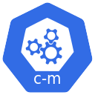

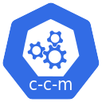


Azure AKS Cluster – Create AKS Cluster using CLI
Azure Cloud
VNET
Default Subnet: 10.240.0.0/16
Load Balancer
System Node Pool: Linux
kubectl
Azure AKS
Cluster Control Plane
Public IP
Virtual Nodes Subnet: 10.241.0.0/16
AKS AdminUser

Slide 53
Azure AKS Cluster – Node Pools (Linux, Windows, Virtual)
Azure Cloud
VNET
Default Subnet: 10.240.0.0/16
Load Balancer
System Node Pool: Linux
kubectl
Azure AKS
Cluster Control Plane
User Node Pool: Linux
Public IP
Virtual Nodes Subnet: 10.241.0.0/16
Azure Container Instances - ACI
User Node Pool: Windows
Virtual Node
AKS AdminUser

Slide 54





Azure Cloud
VNET
AKS Admin
K8s API Server Public IP
Default Subnet: 10.240.0.0/16
AKS
Cluster Control Plane
System Node Pool: Linux
App1
Azure Active
Directory
kubectl
App1 Public IP
User Node Pool: Linux
App2
App2 Public IP
User Node Pool: Windows
App3
App3 Public IP
Load Balancer
Virtual Nodes Subnet: 10.241.0.0/16
App4 Public IP
ACI Virtual Nodes
App4
Deploy Apps to different NodePools using
Kubernetes Node Selector Concept on Azure AKS
K8S Service CIDR: 10.0.0.0/16

Slide 55


Azure AKS Cluster – Node Pools (Linux, Windows)
Azure Cloud
AKS AdminUser
VNET
Default Subnet: 10.240.0.0/16
Load Balancer
System Node Pool: Linux
Azure AKS
Cluster Control Plane
User Node Pool: Linux
Public IP
kubectl
User Node Pool: Windows
Terraform CLI
Terraform Developer

Slide 56
Azure AKS Cluster – Node Pools (Linux, Windows)
Azure Cloud
AKS AdminUser
VNET
Default Subnet: 10.240.0.0/16
Load Balancer
System Node Pool: Linux
Azure AKS
Cluster Control Plane
User Node Pool: Linux
Public IP
kubectl
User Node Pool: Windows
Azure
DevOps

Slide 58
Azure AKS
Create Cluster
Introduction

Slide 59
AKS - Introduction
AKS – Azure Kubernetes Service
AKS is highly available, secure and fully managed Kubernetes Service
As on today available in 36 regions and growing.
When compared to other cloud providers, AKS is the one which is available in highest number of regions
Will be able to run any type of workloads
Windows based applications like .Net Apps
Linux supported applications like Java
IOT device deployment and management on demand
Machine Learning Model training with AKS

Slide 60
AKS Kubernetes - Architecture
Master
Worker Node -1
AKS Kube Controller Manager
Kubelet
Kube-Proxy
Container Runtime (Docker)
kube-apiserver
Worker Node - 2
etcd
kube-scheduler
Kubelet
Kube-Proxy
Container Runtime (Docker)
Container Runtime (Docker)
Azure AKS Cluster Control Plane
Azure AKS Node Pools

Slide 61
Kubernetes
Architecture

Slide 62
Kubernetes - Architecture
Master
Worker Node
Kube Controller Manager
Cloud Controller Manager
Kubelet
Kube-Proxy
Container Runtime (Docker)
kube-apiserver
Worker Node
etcd
kube-scheduler
Kubelet
Kube-Proxy
Container Runtime (Docker)
Container Runtime (Docker)

Slide 63
Kubernetes Architecture - Master
Master
kube-apiserver
It acts as front end for the Kubernetes control plane. It exposes the Kubernetes API
Command line tools (like kubectl), Users and even Master components (scheduler, controller manager, etcd) and Worker node components like (Kubelet) everything talk with API Server.
etcd
Consistent and highly-available key value store used as Kubernetes’ backing store for all cluster data.
It stores all the masters and worker node information.
kube-scheduler
Scheduler is responsible for distributing containers across multiple nodes.
It watches for newly created Pods with no assigned node, and selects a node for them to run on.
Kube Controller Manager
Cloud Controller Manager
kube-apiserver
etcd
kube-scheduler
Container Runtime (Docker)

Slide 64
Kubernetes Architecture - Master
Master
kube-controller-manager
Controllers are responsible for noticing and responding when nodes, containers or endpoints go down. They make decisions to bring up new containers in such cases.
Node Controller: Responsible for noticing and responding when nodes go down.
Replication Controller: Responsible for maintaining the correct number of pods for every replication controller object in the system.
Endpoints Controller: Populates the Endpoints object (that is, joins Services & Pods)
Service Account & Token Controller: Creates default accounts and API Access for new namespaces.
Kube Controller Manager
Cloud Controller Manager
kube-apiserver
etcd
kube-scheduler
Container Runtime (Docker)

Slide 65
Kubernetes Architecture - Master
Master
cloud-controller-manager
A Kubernetes control plane component that embeds cloud-specific control logic.
It only runs controllers that are specific to your cloud provider.
On-Premise Kubernetes clusters will not have this component.
Node controller: For checking the cloud provider to determine if a node has been deleted in the cloud after it stops responding
Route controller: For setting up routes in the underlying cloud infrastructure
Service controller: For creating, updating and deleting cloud provider load balancer
Kube Controller Manager
Cloud Controller Manager
kube-apiserver
etcd
kube-scheduler
Container Runtime (Docker)

Slide 66
Kubernetes Architecture – Worker Nodes
Worker Node
Kubelet
Kubelet is the agent that runs on every node in the cluster
This agent is responsible for making sure that containers are running in a Pod on a node.
Kube-Proxy
It is a network proxy that runs on each node in your cluster.
It maintains network rules on nodes
In short, these network rules allow network communication to your Pods from network sessions inside or outside of your cluster.
Kubelet
Kube-Proxy
Container Runtime (Docker)
Container Runtime
Container Runtime is the underlying software where we run all these Kubernetes components.
We are using Docker, but we have other runtime options like rkt, container-d etc.

Slide 67
Kubernetes - Architecture
Master
Worker Node
Kube Controller Manager
Cloud Controller Manager
Kubelet
Kube-Proxy
Container Runtime (Docker)
kube-apiserver
Worker Node
etcd
kube-scheduler
Kubelet
Kube-Proxy
Container Runtime (Docker)
Container Runtime (Docker)

Slide 68
Kubernetes
Fundamentals
Pod, ReplicaSet, Deployment & Service

Slide 69
Kubernetes - Fundamentals
Pod
A POD is a single instance of an Application.
A POD is the smallest object, that you can create in Kubernetes.
ReplicaSet
A ReplicaSet will maintain a stable set of replica Pods running at any given time.
In short, it is often used to guarantee the availability of a specified number of identical Pods
k8s Fundamentals
Deployment
A Deployment runs multiple replicas of your application and automatically replaces any instances that fail or become unresponsive.
Rollout & rollback changes to applications. Deployments are well-suited for stateless applications.
Service
A service is an abstraction for pods, providing a stable, so called virtual IP (VIP) address.
In simple terms, service sits Infront of a POD and acts as a load balancer.

Slide 70
Kubernetes - Imperative & Declarative
Kubernetes Fundamentals
Imperative
Declarative
kubectl
YAML & kubectl
Pod
Pod
ReplicaSet
ReplicaSet
Deployment
Deployment
Service
Service

Slide 71
Kubernetes
POD

Slide 72
Kubernetes - POD
With Kubernetes our core goal will be to deploy our applications in the form of containers on worker nodes in a k8s cluster.
Kubernetes does not deploy containers directly on the worker nodes.
Container is encapsulated in to a Kubernetes Object named POD.
A POD is a single instance of an application.
A POD is the smallest object that we can create in Kubernetes.
N
Nginx Container
Image
N
N
POD
POD
Worker Node
Worker Node
Node
Worker Node
Kubernetes Cluster

Slide 73

Kubernetes - POD
PODs generally have one to one relationship with containers.
To scale up we create new POD and to scale down we delete the POD.
N
N
N
N
POD
POD
POD
POD
Worker Node - 1
Worker Node - 2
Kubernetes Cluster

Slide 74
Kubernetes – PODs
We cannot have multiple containers of same kind in a single POD.
Example: Two NGINX containers in single POD serving same purpose is not recommended.
N
N
N
N
N
POD
POD
POD
POD
Worker Node - 1
Worker Node - 2
Kubernetes Cluster

Slide 75
Kubernetes – Multi-Container Pods
We can have multiple containers in a single POD, provided they are not of same kind.
Helper Containers (Side-car)
Data Pullers: Pull data required by Main Container
Data pushers: Push data by collecting from main container (logs)
Proxies: Writes static data to html files using Helper container and Reads using Main Container.
Communication
The two containers can easily communicate with each other easily as they share same network space.
They can also easily share same storage space.
Multi-Container Pods is a rare use-case and we will try to focus on core fundamentals.
N
H
POD
Worker Node
Kubernetes Cluster
Helper
Containers
Node

Slide 76
Kubernetes
PODs
Demo

Slide 77
Azure Public
IP Address
Azure Standard
Load Balancer
Kubernetes
Services
Load Balancer

Slide 78

Kubernetes – Service - LoadBalancer
User
Azure Standard
Load Balancer
http://<NEW-PUBLIC-IP>
We can expose an application running on a set of PODs using different types of Services available in k8s.
ClusterIP Service(Internal to k8s cluster)
NodePort Service (To internet)
LoadBalancer Service (To internet)
Ingress Service (To internet)
LoadBalancer Service
To access our application outside of Azure AKS k8s cluster, we can use Kubernetes LoadBalancer service which will be eventually mapped to Azure Standard Load Balancer.
When we deploy k8s load balancer service, the following will happen in Azure Standard Load Balancer
A new Public IP gets created and associates that to Frontend IP Configuration
A new Load Balancing rule will be created which associates frontend ip and backend pool
Updated SLB with FrontendIP & LB Rule
Service
Port: 80
ClusterIP Service Port
targetPort: 80
Container Port in a POD
Node
N
POD
Worker Node
Worker Node
Worker Node
Node
Kubernetes Cluster
Azure Cloud

Slide 79
Azure Public
IP Address
Azure Standard
Load Balancer
Kubernetes
POD & Load Balancer
Service
Demo

Slide 80
Kubernetes
ReplicaSets

Slide 81
Kubernetes - ReplicaSets
High Availability or Reliability
Scaling
ReplicaSets
Load Balancing
Labels & Selectors

Slide 82
Kubernetes – ReplicaSet
A ReplicaSet’s purpose is to maintain a stable set of replica Pods running at any given time.
If our application crashes (any pod dies), replicaset will recreate the pod immediately to ensure the configured number of pods running at any given time.
Reliability
Or
High Availability
N
N
N
POD
POD
POD
ReplicaSet
Worker Node
Kubernetes Cluster

Slide 83

Kubernetes – ReplicaSet
Load Balancing
To avoid overloading of traffic to single pod we can use load balancing.
Kubernetes provides pod load balancing out of the box using Services for the pods which are part of a ReplicaSet
Labels & Selectors are the key items which ties all 3 together (Pod, ReplicaSet & Service), we will know in detail when we are writing YAML manifests for these objects
Service
N
N
N
N
POD
POD
POD
POD
ReplicaSet
Worker Node
Worker Node
Kubernetes Cluster

Slide 84
Kubernetes – ReplicaSet
Scaling
When load become too much for the number of existing pods, Kubernetes enables us to easily scale up our application, adding additional pods as needed.
This is going to be seamless and super quick.
Service
N
N
N
N
POD
POD
POD
POD
ReplicaSet
Worker Node
Worker Node
Kubernetes Cluster

Slide 85
Kubernetes
ReplicaSets
Demo

Slide 86
Kubernetes
Deployments

Slide 87
Kubernetes – Deployments
Service
N
N
N
N
POD
POD
POD
POD
ReplicaSet
Deployment
Worker Node - 1
Worker Node - 2
Kubernetes Cluster

Slide 88
Kubernetes - Deployment
Create a Deployment to rollout a ReplicaSet
Updating the Deployment
Rolling Back a Deployment
Deployments
Scaling a Deployment
Pausing and Resuming a Deployment
Deployment Status
Clean up Policy
Canary Deployments

Slide 89
Kubernetes
Deployments
Demo

Slide 90
Kubernetes
Services

Slide 91
Kubernetes - Services
ClusterIP
Used for communication between applications inside k8s cluster (Example: Frontend application accessing backend application)
NodePort
Used for accessing applications outside of of k8s cluster using Worker Node Ports (Example: Accessing Frontend application on browser)
Services
LoadBalancer
Primarily for Cloud Providers to integrate with their Load Balancer services (Example: AWS Elastic Load Balancer)
Ingress
Ingress is an advanced load balancer which provides Context path based routing, SSL, SSL Redirect and many more (Example: AWS ALB)
externalName
To access externally hosted apps in k8s cluster (Example: Access AWS RDS Database endpoint by application present inside k8s cluster)

Slide 92
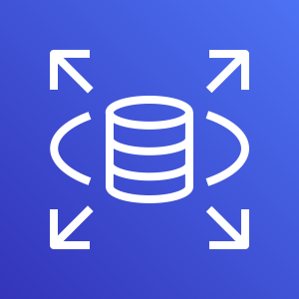
Services
Kubernetes Cluster
Frontend App – NodePort or LoadBalancer or Ingress Service
Users
N
N
N
POD
POD
POD
ReplicaSet
Deployment (app=frontend)
Backend App - ClusterIP Service
AWS Cloud
B
B
B
DB – ExternalName Service
POD
POD
POD
AWS RDS Database
ReplicaSet
Deployment (app=Backend)

Slide 93
Kubernetes
Services
Demo

Slide 94
Services Demo
Kubernetes Cluster
Frontend App – LoadBalance Service
Users
http://<SVC-Public-IP>/hello
N
POD
ReplicaSet
Deployment (app=frontend)
Backend App - ClusterIP Service
B
POD
ReplicaSet
Deployment (app=Backend)

Slide 95
Kubernetes
YAML Basics

Slide 96
YAML Basics
YAML is not a Markup Language
YAML is used to store information about different things
We can use YAML to define key, Value pairs like variables, lists and objects
YAML is very similar to JSON (Javascript Object Notation)
YAML primarily focuses on readability and user friendliness
YAML is designed to be clean and easy to read
We can define YAML files with two different extensions
abc.yml
abc.yaml

Slide 97
YAML Basics
YAML Comments
YAML Key Value Pairs
YAML Dictionary or Map
YAML Array / Lists
YAML Spaces
YAML Document Separator

Slide 98
Azure AKS Storage
with
Azure Disks & Files

Slide 99
AKS Storage Concepts
Storage Concepts
Volumes (K8S)
Persistent Volumes
Storage Classes
Persistent Volume Claims
emptyDir
Azure Disks
default
Dynamically provision the storage
secret
Azure Files
managed-premium
configMap
azurefile
azurefile-premium

Slide 100
Why do we need Persistent Storage in Kubernetes?
Volumes that are defined and created as part of the pod lifecycle only exist until the pod is deleted.
Pods often expect their storage to remain if a pod is rescheduled on a different host during a maintenance event, especially in StatefulSets.
A persistent volume (PV) is a storage resource created and managed by the Kubernetes API that can exist beyond the lifetime of an individual pod.
For AKS, Azure Disks or Azure Files are used to provide the PersistentVolume.
Azure AKS Cluster
Persistent Volume
(Static / Dynamic)
Single Node / Pod Access
Azure Managed Disks
Azure Files
Multiple Concurrent Node / Pod Access
Azure Storage Account

Slide 101
Persistent Volume Claims – How it works?
PVC will request storage based on specifics from Storage class (Disk or File)
Kube API Server will dynamically provision the Persistent Volume PV requested
Once the PV is available it will get mounted to Pod for usage.
create a pod
Azure AKS Cluster
Storage Class
Azure Managed Disks
Premium / Standard
Storage
POD
Persistent Volume Claim
Persistent Volume
Mount the Volume to Pod
Worker Node
Azure Files
(Standard Storage)
Storage Account

Slide 102
Azure AKS Storage
with
Azure Disks

Slide 103
Azure Disks - Introduction
Azure Disk Storage offers high-performance, highly durable block storage for our mission- and business-critical workloads
We can mount these volumes as devices on our Virtual Machines & Container instances.
Cost-effective storage
Built-in bursting capabilities to handle unexpected traffic and process batch jobs cost-effectively
Unmatched resiliency
0 percent annual failure rate for consistent enterprise-grade durability
Seamless scalability
Dynamic scaling of disk performance on Ultra Disk Storage without disruption
Built-in security
Automatic encryption to help protect your data using Microsoft-managed keys or your own

Slide 104
AKS Storage Azure Disks
Azure AKS Cluster
Azure Disks
MySQL – ClusterIP Service
Config Map
Storage Class
Environment Variables
Persistent Volume Claim
Volumes
MySql
Persistent Volumes
Volume Mounts
POD
ReplicaSet
Deployment
Deployment (mysql)
ClusterIP Service

Slide 105
Azure AKS Cluster
http://<External-IP-from-get-service-output>
UserMgmt – LoadBalancer Service
Users
Load Balancer Service
Deployment
Web
App
Environment Variables
POD
ReplicaSet
Init Containers
Azure Disks
Deployment (UserMgmt)
MySQL – ClusterIP Service
Config Map
Storage Class
Environment Variables
Persistent Volume Claim
Volumes
MySql
AKS Storage Azure Disks
Persistent Volumes
Volume Mounts
POD
ReplicaSet
Deployment
Deployment (mysql)
ClusterIP Service

Slide 106
Azure AKS Storage
with
Azure MySQL Database

Slide 107
Azure AKS Cluster
http://<External-IP-from-get-service-output>
UserMgmt – LoadBalancer Service
Users
Load Balancer Service
AKS Storage Azure MySQL
Database
Deployment
Web
App
Environment Variables
POD
ReplicaSet
Init Containers
Drawbacks of Azure Disks
Azure Disks
Deployment (UserMgmt)
Complex setup to achieve HA, Statefulsets
MySQL – ClusterIP Service
Config Map
Complex Master-Master MySQL setup
Storage Class
Environment Variables
Complex Master-Slave MySQL setup
Persistent Volume Claim
Volumes
No Automatic Backup & Recovery
MySql
No Auto-Upgrade MySQL
Persistent Volumes
Volume Mounts
POD
Logging, Monitoring needs custom sctipts
ReplicaSet
Deployment
Deployment (mysql)
ClusterIP Service

Slide 108
Azure MySQL Database
Features
Built-in high availability with no additional cost.
Predictable performance, using inclusive pay-as-you-go pricing.
Scale as needed within seconds.
Secured to protect sensitive data at-rest and in-motion.
Automatic backups and point-in-time-restore for up to 35 days.
Enterprise-grade security and compliance.

Slide 109
Azure AKS Cluster
http://<External-IP-from-get-service-output>
UserMgmt – LoadBalancer Service
Users
Load Balancer Service
Deployment
Web
App
Environment Variables
POD
ReplicaSet
Init Containers
Deployment (UserMgmt)
MySQL – ExternalName Service
High Availability
Monitoring & Alerting
AKS Storage Azure MySQL Database
Backup & Recovery
Automatic Upgrades
Read Replicas
Azure MySQL
Database
Secure Data at rest and motion

Slide 110
Azure AKS Storage
with
Azure Files

Slide 111
Azure Files
These are simple, secure and fully managed cloud file shares
We can secure data at rest and in-transit using SMB 3.0 and HTTPS
We can create high-performance file shares using the Premium Files storage tier
We can replace or supplement on-premises file servers
Scripting and tooling: PowerShell cmdlets and Azure CLI can be used to create, mount, and manage Azure file shares as part of the administration of Azure applications.
We can create and manage Azure file shares using Azure portal and Azure Storage Explorer.
For Application workloads we can use for use cases like Static Content storage, shared configuration access to multiple JVMs etc.

Slide 112
http://<External-IP-from-get-service-output>/app1/file1.html
Azure AKS Cluster
LoadBalancer Service
Users
Load Balancer Service
AKS Storage Azure Files
Deployment
NGINX
NGINX
NGINX
POD
POD
POD
Volumes
ReplicaSet
Deployment
Volume Mounts
Storage Class
Key Advantage with Azure File Shares:
Multiple pods can access the single file share
Azure Storage Account
Persistent Volume Claim
file1.html
file2.html
Persistent Volumes
</>
HTML
</>
HTML
Azure File Shares

Slide 113
Azure AKS
Ingress

Slide 114
Why do we need Ingress?
Azure
AKS
type: LoadBalancer
Public IP-1
Service: App1
App1
Service: App2
App2
Public IP-2
AKS
Load Balancer
No SSL Termination
Public IP-3
Service: App3
App3
We have 3 public Ips for 3 apps – Not good
In simple terms, native Kubernetes services cannot do all the reverse proxy magic and we need something else in k8s do and there comes ingress

Slide 115
What is Ingress?
Ingress is a Kubernetes resource that lets us configure an HTTP load balancer for applications running on Kubernetes, with advanced capabilities at HTTP layer.
Context Path based Routing
Ingress
Features
Host based Routing
TLS / SSL Termination

Slide 116
Ingress - Terminology
Ingress Controller
Ingress Resource or Service
Ingress controller is an application that runs in a cluster and configures an HTTP load balancer according to Ingress resources.
Equivalent to Kubernetes Services but with lot of additional features
The load balancer can be a software load balancer running in the cluster or a hardware or cloud load balancer running externally.
We can define routing rules based on URI or Hostname in Ingress Resource Manifest
In the case of NGINX, the Ingress controller is deployed in a pod along with the load balancer.
We can even define SSL / TLS related information in Ingress Resource Manifest

Slide 117
Azure AKS & Nginx Ingress – Context Path Based Routing
Azure
Azure AKS Cluster
Nginx App1
/app1/
/app2/
/
Ingress Service
Nginx App2
Users
Public IP
for Ingress
Controller
Ingress Controller
AKS
Load Balancer
Usermgmt WebApp

Slide 118
Azure AKS Nginx Ingress Hostname based Routing External DNS
Azure
Azure AKS Cluster
Virtual Machine
Scale Sets
DNS
Zones
Managed
Service
Identity
Nginx App1
External DNS
eapp1.google.com
eapp2. google.com
eapp3. google.com
Nginx App2
Ingress Service
Users
Public IP
for Ingress
Controller
Ingress Controller
AKS
Load Balancer
Usermgmt WebApp

Slide 119
Azure AKS Nginx Ingress External DNS SSL with Lets Encrypt
Azure
Azure AKS Cluster
Virtual Machine
Scale Sets
External DNS
DNS
Zones
Managed
Service
Identity
cert-manager
sapp1. google.com
sapp2. google.com
Nginx App1
Ingress Service
Users
Public IP
for Ingress
Controller
Ingress Controller
AKS
Load Balancer
Nginx App2

Slide 120
Nginx Ingress Controller - References
List of Ingress Controllers
https://kubernetes.io/docs/concepts/services-networking/ingress-controllers/
Azure AGIC (Application Gateway Ingress Controller)
https://github.com/Azure/application-gateway-kubernetes-ingress
https://azure.microsoft.com/en-in/pricing/details/application-gateway/

Slide 121
Azure AKS
Nginx Ingress Service
Install & Implement

Slide 122
Azure AKS & Nginx Ingress – Basic Architecture
Azure Cloud
Azure AKS Cluster
Nginx App1
/
Ingress Service
Users
Public IP
for Ingress
Controller
Ingress Controller
AKS
Load Balancer

Slide 123
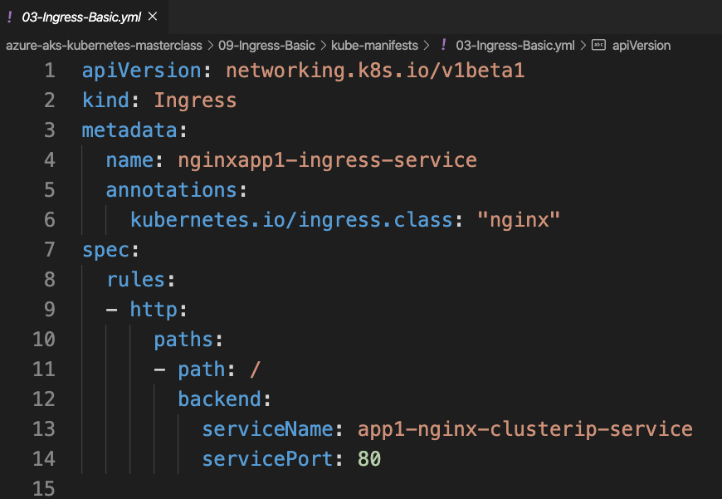
Basic Ingress Manifest

Slide 124
Azure AKS
Nginx Ingress Service
Context Path based Routing

Slide 125
Azure AKS & Nginx Ingress – Context Path Based Routing
Azure
Azure AKS Cluster
Nginx App1
/app1/
/app2/
/
Ingress Service
Nginx App2
Users
Public IP
for Ingress
Controller
Ingress Controller
AKS
Load Balancer
Usermgmt WebApp

Slide 126
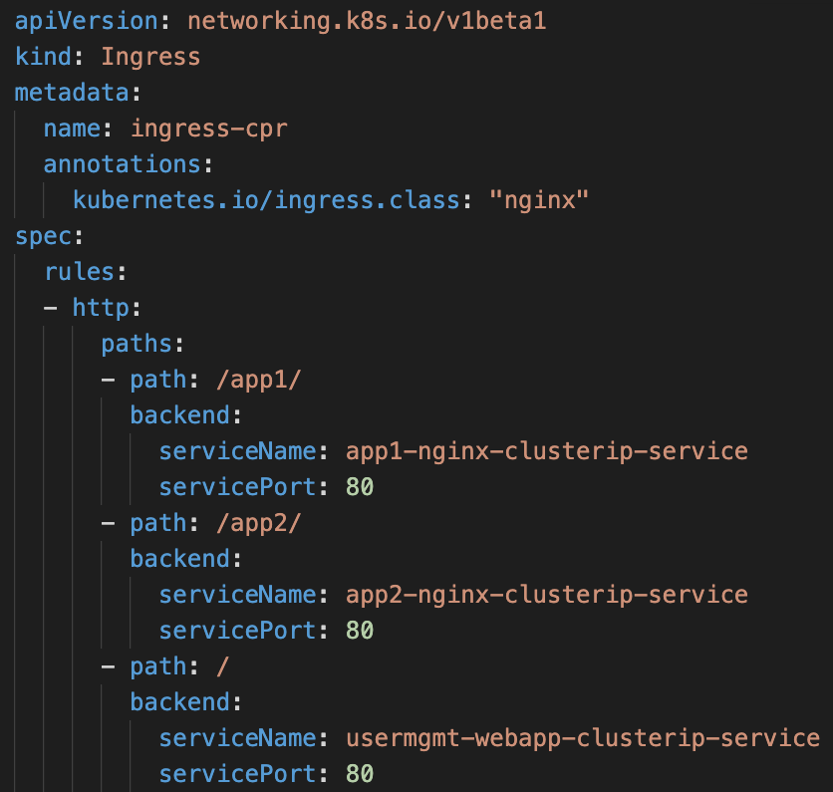
Ingress CPR Manifest

Slide 127
Azure AKS
&
Azure DNS Zones

Slide 128
Domain Registrar
A domain registrar is a company who can provide Internet domain names.
Example: GoDaddy, Wix, Namcheap, AWS Route53
They verify if the Internet domain you want to use is available and allow you to purchase it.
Once the domain name is registered, you are the legal owner for the domain name.
If you already have an Internet domain, you will use the current domain registrar to delegate to Azure DNS.

Slide 129
DNS Zone
A domain is a unique name in the Domain Name System, for example google.com.
A DNS zone is used to host the DNS records for a particular domain.
For example, the domain google.com may contain several DNS records such as
mail. google.com (for a mail server)
www. google.com (for a website).
courses. google.com (Sub domains to host other applications)

Slide 130
Azure DNS Zones
Azure DNS is not the domain registrar.
Azure DNS allows you to host a DNS zone and manage the DNS records for a domain in Azure.
For DNS queries for a domain to reach Azure DNS, the domain must be delegated to Azure DNS from the parent domain

Slide 131
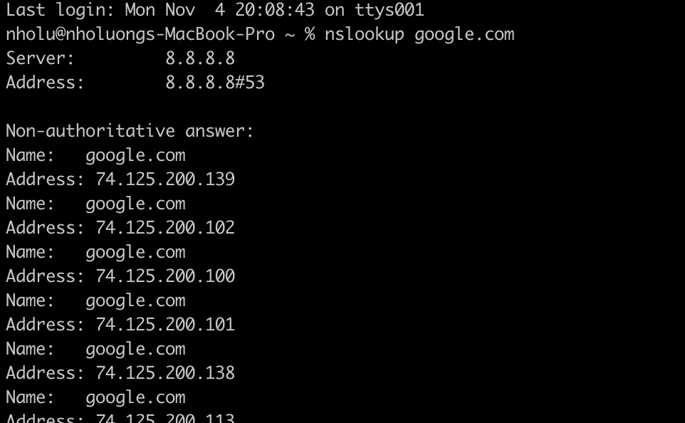
Delegate Domain to Azure DNS
AWS Cloud
Azure Cloud
DNZ Zones
Domain Registrar
google.com
google.com
AWS Route53
Azure DNS Zones

Slide 132
DNS
Zones
Managed
Service
Identity
Azure AKS
Nginx Ingress Service
External DNS

Slide 133
Kubernetes External DNS
ExternalDNS synchronizes exposed Kubernetes Services and Ingresses with DNS providers.
In simple terms, ExternalDNS allows you to control DNS records dynamically via Kubernetes resources in a DNS provider-agnostic way.
Reference: https://github.com/nholuongut/external-dns

Slide 134
Azure AKS Nginx Ingress External DNS
Azure
Azure AKS Cluster
Virtual Machine
Scale Sets
DNS
Zones
Managed
Service
Identity
Nginx App1
External DNS
eapp1.kubeoncloud.com
Ingress Service
eapp1.kubeoncloud.com
Users
Public IP
for Ingress
Controller
Ingress Controller
AKS
Load Balancer

Slide 135
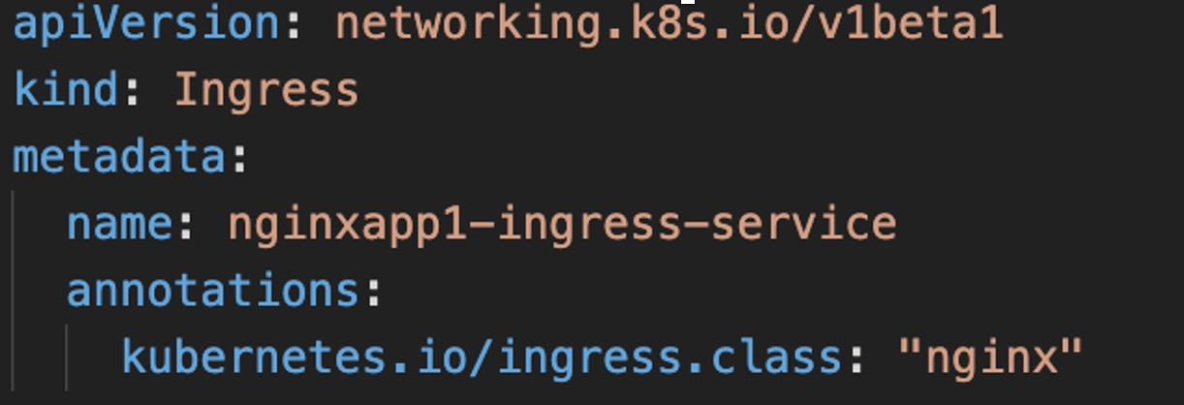
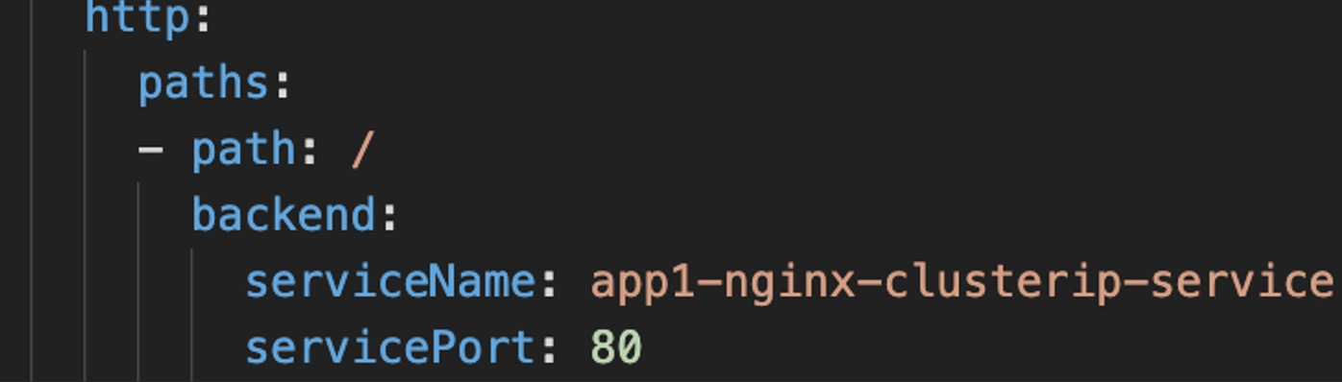
Ingress with External DNS
This will help us to add DNS Record Set in Azure DNS Zones using k8s External DNS

Slide 136
DNS
Zones
Managed
Service
Identity
Azure AKS
Nginx Ingress Service
Domain Name
based
Routing

Slide 137
Azure AKS Nginx Ingress External DNS Domain Name based Routing
Azure
Azure AKS Cluster
Virtual Machine
Scale Sets
DNS
Zones
Managed
Service
Identity
Nginx App1
External DNS
eapp1.kubeoncloud.com
eapp2.kubeoncloud.com
Users
eapp1.goole.com
eapp3.kubeoncloud.com
Nginx App2
Ingress Service
eapp2.google.com
Public IP
for Ingress
Controller
Ingress Controller
AKS
Load Balancer
Usermgmt WebApp
eapp3.google.com

Slide 138
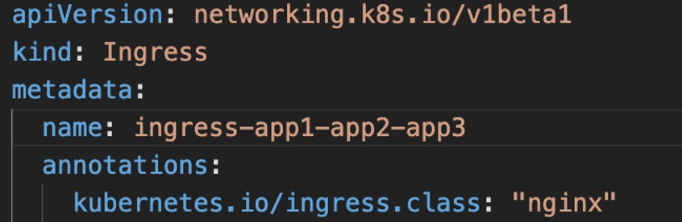
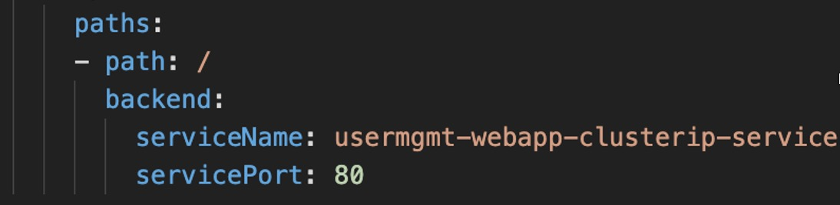
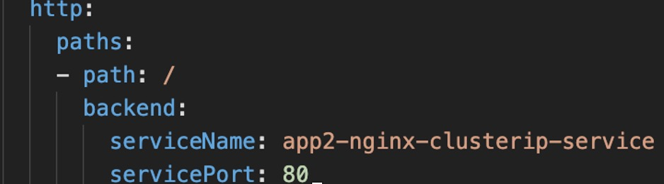
Ingress with External DNS and Domain Name based Routing
Ingress
Domain Name
Based
Routing

Slide 139
DNS
Zones
Managed
Service
Identity
Azure AKS
Nginx Ingress Service
Ingress SSL
Automatically generate and renew ssl certificates

Slide 140
Kubernetes Cert Manager
cert-manager is a native Kubernetes certificate management controller.
It can help with issuing certificates from a variety of sources, such as Let’s Encrypt, HashiCorp Vault, Venafi, a simple signing key pair, or self signed.
It will ensure certificates are valid and up to date, and attempt to renew certificates at a configured time before expiry.
Reference: https://cert-manager.io/docs/

Slide 141
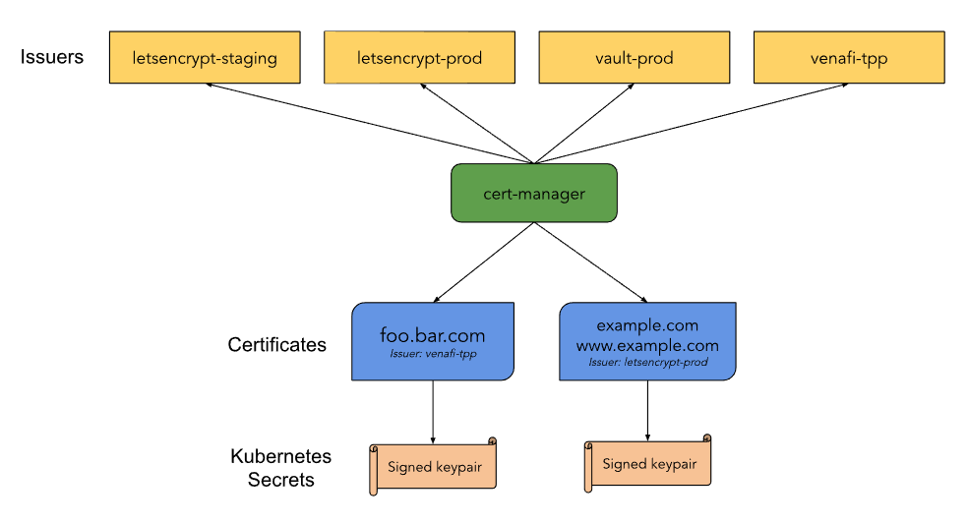
Kubernetes cert-manager

Slide 142
Azure AKS Nginx Ingress External DNS SSL with Lets Encrypt
Azure
Azure AKS Cluster
Virtual Machine
Scale Sets
External DNS
DNS
Zones
Managed
Service
Identity
5 mins to 1 hour
cert-manager
sapp1.kubeoncloud.com
sapp2.kubeoncloud.com
https://sapp1.google.com/app1/index.html
Nginx App1
https://sapp2.google.com/app2/index.html
Ingress Service
HTTPS
Users
Public IP
for Ingress
Controller
Ingress Controller
AKS
Load Balancer
Nginx App2

Slide 143

Ingress with External DNS, DNR and SSL
Ingress SSL Settings

Slide 144
Kubernetes
Resources
Requests & Limits

Slide 145
Kubernetes - Resources Requests & Limits
We can specify how much each container in a pod needs the resources like CPU & Memory.
When we provide this information in our pod definition for a specific container, the scheduler uses this information to decide which node to place the Pod on based on availability of k8s worker Node CPU and Memory Resources.
When you specify a resource limit for a Container, the kubelet enforces those `limits` so that the running container is not allowed to use more of that resource than the limit you set.
The kubelet also reserves at least the request amount of that system resource specifically for that container to use.

Slide 146
Kubernetes – Requests & Limits
K8s cluster
K8s Node
default namespace
CPU: 8 vcores
(8000m)
Container-1
Container-2
Memory: 32GB
CPU: 500m
CPU: 1000m
CPU: 500m
CPU: 1000m
Mem: 128Mi
Mem: 500Mi
Mem: 128Mi
Mem: 500Mi
Requests
Limits
Requests
Limits

Slide 147


Kubernetes Requests & Limits
We have defined Requests & Limits for a specific container in a Deployment Manifest.

Slide 148
Kubernetes
Namespaces

Slide 149

Kubernetes - Namespaces
Namespaces are also called Virtual clusters in our physical k8s cluster
We use this in environments where we have many users spread across multiple teams or projects
Clusters with tens of users ideally don’t need to use namespaces
Benefits
Creates isolation boundary from other k8s objects
We can limit the resources like CPU, Memory on per namespace basis (Resource Quota).

Slide 150

Kubernetes - Namespaces
LoadBalancer Service
LoadBalancer Service
LoadBalancer Service
F
F
F
Pod
Pod
Pod
Namespace Manifest - Declarative
ReplicaSet
ReplicaSet
ReplicaSet
Deployment
Deployment
Deployment
ClusterIP Service
ClusterIP Service
ClusterIP Service
B
B
B
Pod
Pod
Pod
ReplicaSet
ReplicaSet
ReplicaSet
Deployment
Deployment
Deployment
Namespace: dev
Namespace: qa
Namespace: staging
Namespace Manifest - Imperative
Deployment

Slide 151
Kubernetes - Namespaces
K8s cluster
K8s Node
default namespace
dev namespace
qa namespace
App1
App1
App1
App2
App2
App2

Slide 152
Kubernetes - Namespaces & DNS
K8s cluster
K8s Node
default namespace
dev namespace
qa namespace
App1
App1
App1
app1.default.svc.cluster.local
app1.dev.svc.cluster.local
app1.qa.svc.cluster.local
<service-name>.<namespace-name>.svc.cluster.local

Slide 153
Kubernetes
Namespaces
Limit Range

Slide 154
Namespaces – Limit Range
By default, containers run with unbounded compute resources on a Kubernetes cluster.
With resource quotas, cluster administrators can restrict resource consumption and creation on a namespace basis.
Within a namespace, a Pod or Container can consume as much CPU and memory as defined by the namespace's resource quota.
There is a concern that one Pod or Container could monopolize all available resources.
A LimitRange is a policy to constrain resource allocations (to Pods or Containers) in a namespace.

Slide 155
Namespaces – Limit Range
A LimitRange provides constraints that can:
Enforce minimum and maximum compute resources usage per Pod or Container in a namespace.
Enforce minimum and maximum storage request per PersistentVolumeClaim in a namespace.
Enforce a ratio between request and limit for a resource in a namespace.
Set default request/limit for compute resources in a namespace and automatically inject them to Containers at runtime.

Slide 156
Limit Range
LoadBalancer Service
LoadBalancer Service
LoadBalancer Service
F
F
F
Pod
Pod
Pod
Limit Range Manifest
ReplicaSet
ReplicaSet
ReplicaSet
Deployment
Deployment
Deployment
ClusterIP Service
ClusterIP Service
ClusterIP Service
B
B
B
Pod
Pod
Pod
ReplicaSet
ReplicaSet
ReplicaSet
Deployment
Deployment
Deployment
Deployment
CPU
Memory
CPU
Memory
CPU
Memory
default
Min/Max
default
Min/Max
default
Min/Max
Limit Range (Per Container)
Limit Range (Per Container)
Limit Range (Per Container)
Namespace: dev
Namespace: qa
Namespace: staging

Slide 157
Kubernetes
Namespaces
Resource Quota

Slide 158
Namespaces - Resource Quota
When several users or teams share a cluster with a fixed number of nodes, there is a concern that one team could use more than its fair share of resources.
Resource quotas are a tool for administrators to address this concern.
A resource quota, defined by a ResourceQuota object, provides constraints that limit aggregate resource consumption per namespace.
It can limit the quantity of objects that can be created in a namespace by type, as well as the total amount of compute resources that may be consumed by resources in that project.

Slide 159
Resource Quota
LoadBalancer Service
LoadBalancer Service
LoadBalancer Service
F
F
F
Resource Quota Manifest
Pod
Pod
Pod
ReplicaSet
ReplicaSet
ReplicaSet
Deployment
Deployment
Deployment
ClusterIP Service
ClusterIP Service
ClusterIP Service
B
B
B
Pod
Pod
Pod
ReplicaSet
ReplicaSet
ReplicaSet
Deployment
Deployment
Deployment
Deployment
CPU
Memory
CPU
Memory
CPU
Memory
Pods
Services
Pods
Services
Pods
Services
Resource Quota
Resource Quota
Resource Quota
Namespace: dev
Namespace: qa
Namespace: staging

Slide 160
Azure AKS
Virtual Nodes
(Serverless)

Slide 161
Azure AKS Virtual Nodes
Virtual Kubelet
Azure Container Instances
ACI
Azure Virtual Nodes on
AKS
+
=

Slide 162
What is Virtual Kubelet?
Virtual Kubelet
Virtual Kubelet is an open source Kubernetes kubelet implementation that acts as a kubelet for the purposes of connecting Kubernetes to other APIs.
This allows the k8s worker nodes to be backed by other services like Azure ACI and AWS Fargate
The primary scenario for VK is enabling the extension of the Kubernetes API into serverless container platforms like Azure ACI and AWS Fargate

Slide 163

How Virtual-Kubelet works?
Virtual Kubelet
Current Features
create, delete and update pods
container logs, exec, and metrics
get pod, pods and pod status
capacity
node addresses, node capacity, node daemon endpoints
operating system
bring your own virtual network

Slide 164
What is ACI (Azure Container Instances)?
Azure Container Instances (ACI) provide a hosted environment for running containers in Azure.
When using ACI, there is no need to manage the underlying compute infrastructure, Azure handles this management for you.
When running containers in ACI, you are charged by the second for each running container
Azure Container Instances

Slide 165
Kubernetes Virtual Kubelet with Azure ACI
The Azure Container Instances (ACI) provider for the Virtual Kubelet configures an ACI instance as a node in any Kubernetes cluster.
When using the Virtual Kubelet ACI provider, pods can be scheduled on an ACI instance as if the ACI instance is a standard Kubernetes node.
This configuration allows you to take advantage of both the capabilities of Kubernetes and the management value and cost benefit of ACI.
Virtual
Kubelet
Azure Container Instances

Slide 166
Virtual Kubelet's ACI provider - Features
Virtual
Kubelet
Volumes: empty dir, github repo, Azure Files
Secure env variables, config maps
Bring your own virtual network (VNet)
Network security group support
Basic Azure Networking support within AKS virtual node
Exec support for container instances
Azure Monitor integration or formally known as OMS
+
Azure Container Instances
=
Azure AKS Virtual Nodes

Slide 167
Azure AKS – Virtual Nodes (Serverless)
Azure Virtual Nodes on
AKS
We can run our Kubernetes workloads on Serverless Infrastructure of Azure which is called Virtual Nodes
Advantages
Scale our applications rapidly without any limitations
Quick Provisioning of pods using Virtual Nodes when compared to cluster autoscaler.
Cluster Autoscaler need to provision the Nodes in a managed node pool first then only Kubernetes can schedule pods on those newly provisioned nodes.
Limitations (Huge and Many)
https://docs.microsoft.com/en-us/azure/aks/virtual-nodes-cli#known-limitations

Slide 168
Azure AKS - Virtual Nodes
Azure Cloud
Azure AKS Cluster
VNET1
AKS Cluster
Control Plane
Node Pool
Virtual Nodes
Azure Container Instance - ACI
Subnet: default
Subnet: virtual-node-aci

Slide 169


AKS Virtual Nodes NodeSelector

Slide 170
Azure AKS
Virtual Nodes
(Serverless)
Mixed Mode Deployments

Slide 171
Azure AKS Cluster
http://<External-IP-from-get-service-output>
UserMgmt – LoadBalancer Service
Users
Load Balancer Service
Deployment
Web
App
Environment Variables
POD
ReplicaSet
Init Containers
Azure Disks
Deployment (UserMgmt)
MySQL – ClusterIP Service
Config Map
Storage Class
Environment Variables
Persistent Volume Claim
Volumes
MySql
AKS Storage Azure Disks
Persistent Volumes
Volume Mounts
POD
ReplicaSet
Deployment
Deployment (mysql)
ClusterIP Service

Slide 172
Azure AKS - Virtual Nodes Mixed Mode Deployments
Azure Cloud
Azure AKS Cluster
VNET1
MySQL Cluster IP Service
UserMgmt LoadBalancer Service
MySQL Pod
Usermgmt Pod
Virtual Node
AKS Worker Node
Node Pool
Azure Container Instance - ACI
Subnet: default
AKS Cluster
Control Plane
Subnet: virtual-node-aci
Azure Disks

Slide 173
Azure AKS
Azure Container Registry (ACR)

Slide 174
Azure Container Registry - Introduction
Azure Container Registry is a managed, private Docker registry service
We can create and maintain Azure container registries to store and manage our private Docker container images.
With ACR, we can simplify our container lifecycle management.
Geo-replication to efficiently manage a single registry across multiple regions
Automated container building and patching including base image updates and task scheduling
Integrated security with Azure Active Directory (Azure AD) authentication, role-based access control, Docker Content Trust and virtual network integration

Slide 175
Azure ACR and AKS - Integration
Docker Developer
Azure Cloud
Azure Container
Registry
Azure AKS Cluster
Build and Push
Docker Image
Integrate ACR and AKS
Azure AKS Cluster
Control Plane
Pull Docker Image from ACR
http://<public-ip>
Users
Public IP
App1 LB
Nginx App1
AKS
Load Balancer

Slide 176
Pull Docker Images from ACR using Service Principal
Run on Azure AKS Nodepools
Docker Developer
Azure Cloud
Azure Container
Registry
Azure AKS Cluster
Build and Push
Docker Image
Azure AKS Cluster
Control Plane
Pull Docker Image from ACR
docker-server
docker-username
http://<public-ip>
docker-password
Users
Public IP
App1 LB
Nginx App1
AKS
Load Balancer

Slide 177
Pull Docker Images from ACR using Service Principal
Run on Azure Virtual Nodes
Docker Developer
Azure Cloud
Azure Container
Registry
Azure AKS Cluster
Azure AKS Cluster
Control Plane
Build and Push
Docker Image
Pull Docker Image from ACR
docker-server
docker-username
docker-password
http://<public-ip>
Nginx App1
Users
Public IP
App1 LB
Virtual Node - ACI
AKS
Load Balancer

Slide 178
Azure Container Registry – Pricing Tiers
Basic
Standard
Premium
Enabled as Public Endpoint
(Public Docker Registry)
Enabled as Public Endpoint
(Public Docker Registry)
Enabled as Public & Private Endpoint (Private Docker Registry)
No Customer Managed Key for Encryption
No Customer Managed Key for Encryption
Can use Customer Managed Key for Encryption
Storage: 10GB (Max Up to 20TB)
Storage: 100GB (Max Up to 20TB)
Storage: 500GB (Max Up to 20TB)
No Geo Replication & Content Trust
No Geo Replication & Content Trust
Supports Geo Replication & Content Trust
Download Speed: 30MBps
Upload Speed: 10MBps
Download Speed: 60MBps
Upload Speed: 20MBps
Download Speed: 100MBps
Upload Speed: 50MBps
$0.167 per day + Other Charges
$0.667 per day + Other Charges
$1.667 per day + Other Charges
Reference: https://docs.microsoft.com/en-us/azure/container-registry/container-registry-skus#service-tier-features-and-limits

Slide 179
Azure AKS
Azure Container Registry (ACR)
Integrate ACR & AKS

Slide 180
Azure ACR and AKS - Integration
Docker Developer
Azure Cloud
Azure Container
Registry
Azure AKS Cluster
Build and Push
Docker Image
Integrate ACR and AKS
Azure AKS Cluster
Control Plane
Pull Docker Image from ACR
http://<public-ip>
Users
Public IP
App1 LB
Nginx App1
AKS
Load Balancer

Slide 181
Run
AKS Node Pools
Azure AKS
Azure Container Registry (ACR)
Pull Images from ACR using Service Principal

Slide 182
Pull Docker Images from ACR using Service Principal
Run on Azure AKS Nodepools
Docker Developer
Azure Cloud
Azure Container
Registry
Azure AKS Cluster
Build and Push
Docker Image
Azure AKS Cluster
Control Plane
Pull Docker Image from ACR
docker-server (ACR)
docker-username
http://<public-ip>
docker-password
Users
Public IP
App1 LB
Nginx App1
AKS
Load Balancer
AKS Node Pool

Slide 183
Schedule on
AKS Virtual Nodes
Azure AKS
Azure Container Registry (ACR)
Pull Images from ACR using Service Principal

Slide 184
Pull Docker Images from ACR using Service Principal
Run on Azure Virtual Nodes
Docker Developer
Azure Cloud
Azure Container
Registry
Azure AKS Cluster
Azure AKS Cluster
Control Plane
Build and Push
Docker Image
Pull Docker Image from ACR
docker-server (ACR)
docker-username
docker-password
http://<public-ip>
Nginx App1
Users
Public IP
App1 LB
Virtual Node - ACI
AKS
Load Balancer

Slide 185
Azure AKS
Azure DevOps
Introduction

Slide 186
Github
Azure
DevOps
Azure
Pipelines
Azure
Container Registry
Azure AKS
Azure DevOps
Build & Push
Docker Image to ACR

Slide 187
Azure DevOps Pipelines – Build & Push Docker Image to ACR
Azure Cloud
Azure DevOps
Github
Azure Pipelines
(Build & Push)
Azure Container Registry
Developer

Slide 188

Azure DevOps Pipelines – Build & Push Docker Image to ACR

Slide 189
Github
Azure
DevOps
Azure
Pipelines
Azure
Container Registry
Azure AKS
Azure DevOps
Build & Push
Docker Image to ACR
Deploy to AKS

Slide 190
Azure DevOps – Build & Push Docker Image to ACR & Deploy to AKS
Azure DevOps
Azure Cloud
Developer
Azure Pipelines
1
2
Stage-1: Build & Push to ACR
4
Stage-2: Deploy to AKS
Github
5
Azure AKS Cluster
3
default namespace
Nginx App1
6
Azure Container Registry

Slide 191
Github
Azure
DevOps
Azure
Pipelines
Azure
Container Registry
Azure AKS
Azure DevOps
Build & Push
Docker Image to ACR, Publish Artifacts
STARTER PIPELINE

Slide 192
Azure Pipelines – Key Concepts
Pipeline
Stages
Steps
Trigger
Stage-1: Build
Agent
Step-1: script: echo Hello, world!
Job
Stage-2: AA
Step-2: Task-1: Docker Build & Push to ACR
Github
Agent
Stage-3: BB
Job
Step-3: Task-2: Copy Files to Build Artifact Directory
Stage-4: CC
Job
Step-4: Task-3: Publish Artifacts to Azure Pipelines
Developer

Slide 193
Azure Pipelines – Key Concepts
Stages
Stage-1
Jobs
Job-1
Steps
Step-1: Script
Step-2: Task
Job-2
Steps
Step-1: Task
Step-2: Task
Stage-2
Jobs
Job-1
Steps
Step-1: Script
Step-2: Script
Job-2
Steps
Step-1: Task
Step-2: Task

Slide 194
Azure Pipelines – Starter Pipeline
Goal
Create a Pipeline that will build docker images, push them to Azure Container Registry and Publish Kubernetes Manifests to Azure Pipelines
Part-1
Semi Customized
Part-2
Fully Customized using Starter Pipeline
Task-1
Use pre-defined Docker Build & Push Pipeline
Task-1
Start using Starter pipeline and use Docker Build or Push Docker Images Task
Task-2
Customize Pipeline to Use Copy Files Task
Task-2
Customize Pipeline to Use Copy Files Task
Task-3
Customize Pipeline to Use Publish Build Artifacts Task
Task-3
Customize Pipeline to Use Publish Build Artifacts Task

Slide 195
Azure DevOps – Build Pipeline
Task-1
Docker Image Build and Push to Azure Container Registry
Task-2
Copy files (kube-manifests folder) from System default working Directory to Build Artifact Directory
Task-3
Publish Build Artifacts to Azure Pipelines, so that we can use them in Release Pipelines

Slide 196
Azure
DevOps
Azure
Pipelines
Azure
Container Registry
Azure
Release Pipelines
Github
Azure AKS
Azure DevOps
Release Pipelines
Continuous Delivery

Slide 197
Azure DevOps – Release Pipelines
To achieve Continuous Delivery we use Release Pipelines

Slide 198
Azure DevOps – Release Pipelines

Slide 199
Developer
Github
Azure DevOps – Release Pipelines
1
2
Azure Cloud
Azure DevOps
Release Pipelines
QA
Azure Pipelines
7
Stage-1: Build & Push to ACR
4
Dev
Staging
12
Prod
3
10
Azure Container Registry
6
5
9
8
Azure AKS Cluster
12
11
14
13
dev namespace
qa namespace
Staging namespace
prod namespace
Nginx App1
Nginx App1
Nginx App1
Nginx App1

Slide 200
Azure Release Pipelines

Slide 201
Azure Release Pipelines - Releases

Slide 202
AKS Addon
DNS
Zones
Managed
Service
Identity
Azure AKS
HTTP Application Routing Add On
Ingress Controller + External DNS

Slide 203
Azure AKS - Addons
Virtual Nodes
Monitoring
(Log Analytics)
Azure AKS Cluster
HTTP Application Routing
Ingress + External DNS
Azure Policy

Slide 204
Azure AKS HTTP Application Routing Add On Ingress + External DNS (Automatic Install)
Azure Cloud
Azure AKS Cluster
app1.7b8803340f38495c8402.centralus.aksapp.io
7b8803340f38495c8402.centralus.aksapp.io
DNS Zones
Nginx App1
External DNS
app1.7b8803340f38495c8402.centralus.aksapp.io
app1.7b8803340f38495c8402.centralus.aksapp.io
Users
Public IP
for Ingress
Controller
Ingress Controller
Ingress Service
AKS
Load Balancer
HTTP Application Routing Add On

Slide 205

Ingress with External DNS
This annotation will ensure the ingress service we are creating will be part Ingress Controller created using HTTP Application Routing Add On
This will help us to add DNS Record Set in Azure DNS Zones using k8s External DNS

Slide 206
Azure AKS
Configure Access
To
Multiple AKS Clusters

Slide 207
Azure AKS Cluster Access
AKS Cluster - 1
AKS Cluster-1
kubectl
Current Context
AKS Admin
AKS Cluster-2
AKS Cluster - 2

Slide 208
Azure Active Directory
Azure AD Groups
Azure AD Users
Azure AKS
Azure AD Authentication
for
AKS Admins

Slide 209
Azure Active Directory Authentication for AKS Admins
Integrate Azure AD and AKS Cluster
Azure Active Directory
Azure AKS Cluster
Azure AD Group: k8sadmins
Your Desktop
kubectl
K8S API Server
Azure AD User: user1aksadmin
Terminal

Slide 210
Azure Active Directory Authentication for AKS Admins
Authentication
Your Desktop
Azure AKS Cluster
Terminal
2
Browser
1
kubectl get nodes
Azure Active Directory
4
3
Credentials Cached
Azure AD User: user1aksadmin
K8S API Server
Azure AD Group: k8sadmins

Slide 211
Role
Role Binding
Cluster Role
Cluster Role Binding
Azure AKS
Kubernetes RBAC
Azure Active Directory
Active Directory
AD Groups
AD Users

Slide 212
Kubernetes RBAC
Kubernetes RBAC - Fundamentals
Subjects
API Groups
Resources
Verbs
Users or processes that need access to the Kubernetes API
The k8s API objects that we grant access to
List of actions that can be taken on a resource
Kind: Group, User
core
Pods
Create
Patch
Kind: Service Account
extensions
Deployments
List
get
apps
Services
Watch
Replace
batch
StatefulSets
Delete
Read
Reference: https://kubernetes.io/docs/reference/generated/kubernetes-api/v1.19

Slide 213
Kubernetes RBAC
Kubernetes Cluster RBAC
Cluster Role Binding
Cluster Role
Namespace: DEV
Namespace: QA
User / Group
(Subject)
Create
(Verb)
Role Binding
Role Binding
Role
Role
User / Group
(Subject)
Create
(Verb)
Pod
(Resource)
User / Group
(Subject)
Create
(Verb)
Pod
(Resource)

Slide 214
Role
Role Binding
Azure AKS
Kubernetes RBAC
Azure Active Directory
Active Directory
AD Groups
AD Users

Slide 215

Kubernetes RBAC Role
Role
A Role can only be used to grant access to resources within a single namespace.
Namespace: Creating this role in dev namespace
API Groups: core, extensions, apps
Resources: pods, deployments, services
Verbs: Create, List, Delete, Patch

Slide 216

Kubernetes RBAC Role Binding
Role Binding
A Role Binding is used to tie the Role and Subject together
Role
Subjects
Namespace: Creating this role binding in dev namespace
Role: Mapped role here
Subjects: Group: Azure AD Group with Object ID xxx has full access to namespace dev in AKS Cluster

Slide 217
Azure Active Directory & Kubernetes RBAC
Azure AKS Kubernetes Cluster
Namespace: DEV
Namespace: QA
Role Binding
Role Binding
Role
Role
User / Group
(Subject)
Create
(Verb)
Pod
(Resource)
User / Group
(Subject)
Create
(Verb)
Pod
(Resource)
Azure AD Group: devaksteam
Azure AD User: aksdev1
Azure Active Directory
Object ID: e6dcdae4-e9ff-4261-81e6-0d08537c4cf8

Slide 218
Azure Active Directory & Kubernetes RBAC
Authentication
k8s Role
k8s Role Binding
Azure AKS Kubernetes Cluster
Namespace: DEV
Role Binding
Azure Active Directory
Role
Integrate Azure AD Group & Kubernetes RBAC
User / Group
(Subject)
get
(Verb)
Pod
(Resource)
Azure AD Group: devaksteam
Credentials Cached
5
Object ID: e6dcdae4-e9ff-42
61-81e6-0d08537c4cf8
3
Access
Granted
kubectl get pods -n dev
4
2
1
Azure AD User: aksdev1
Terminal
Your Desktop

Slide 219
Azure Active Directory & Kubernetes RBAC
Authentication
Azure AKS Kubernetes Cluster
k8s Role
k8s Role Binding
Namespace: DEV
Role Binding
Azure Active Directory
Role
Integrate Azure AD Group & Kubernetes RBAC
User / Group
(Subject)
get
(Verb)
Pod
(Resource)
Azure AD Group: devaksteam
Credentials Cached
Object ID: e6dcdae4-e9ff-42
61-81e6-0d08537c4cf8
3
Namespace: QA
kubectl get pods -n qa
Role Binding
2
Role
1
4
Access
Denied
User / Group
(Subject)
get
(Verb)
Pod
(Resource)
Azure AD User: aksdev1
Terminal
Your Desktop

Slide 220
Cluster Role
Cluster Role Binding
Azure AKS
Kubernetes RBAC
Azure Active Directory
Active Directory
AD Groups
AD Users

Slide 221

Kubernetes RBAC Cluster Role
Cluster Role
A ClusterRole can be used to grant the same permissions as a Role, but because they are cluster-scoped, access will be granted across cluster
Read Only access to AKS Cluster
Read Only access to AKS Cluster

Slide 222

Kubernetes RBAC Cluster Role Binding
Cluster Role Binding
A Cluster Role Binding is used to tie the Cluster Role and Subject together
Cluster Role
Subjects
(AD Group)
Role: Mapped role here
Subjects: Group: Azure AD Group with Object ID xxx has read only access to AKS Cluster

Slide 223
Azure Active Directory & Kubernetes RBAC
Authentication
k8s Cluster Role
Azure AKS Kubernetes Cluster
Cluster Role Binding
k8s Cluster Role Binding
Azure Active Directory
Cluster Role
Integrate Azure AD Group & Kubernetes RBAC
User / Group
(Subject)
Get
(Verb)
Azure AD Group: aksreadonly
Access
Granted
(Resources)
Object ID: e6dcdae4-e9ff-42
61-81e6-0d08537c4cf8
4
3
Credentials Cached
kubectl get nodes
1
2
Read Only User
Terminal
Azure AD User: aksread1
Your Desktop

Slide 224
Azure Active Directory & Kubernetes RBAC
Authentication
k8s Cluster Role
Azure AKS Kubernetes Cluster
Cluster Role Binding
k8s Cluster Role Binding
Azure Active Directory
Cluster Role
Integrate Azure AD Group & Kubernetes RBAC
User / Group
(Subject)
Get
(Verb)
Azure AD Group: aksreadonly
Access
Denied
(Resources)
Object ID: e6dcdae4-e9ff-42
61-81e6-0d08537c4cf8
4
3
Credentials Cached
kubectl create ns dev
1
2
Read Only User
Terminal
Azure AD User: aksread1
Your Desktop

Slide 225
Cluster Autoscaler
Horizontal
Pod
Autoscaler
Azure AKS
Autoscaling
Nodes & Pods

Slide 226
Azure AKS – Autoscaling Nodes & Pods
Azure Kubernetes Service (AKS) Cluster
Automatically auto-scale nodes
Cluster Autoscaler
Scale out
Automatically auto-scale pods
Horizontal Pod Autoscaler
Scale out

Slide 227
Azure AKS
Autoscaling
Cluster Autoscaler

Slide 228
Cluster Autoscaler - Introduction
Cluster Autoscaler is a tool that automatically adjusts the size of a Kubernetes cluster when one of the following conditions is true:
There are pods that failed to run in the cluster due to insufficient resources.
There are nodes in the cluster that have been underutilized for an extended period of time and their pods can be placed on other existing nodes.
The Cluster Autoscaler modifies our nodepools so that they scale out when we need more resources and scale in when we have underutilized resources.

Slide 229
Azure AKS
Autoscaling
Horizontal Pod Autoscaling

Slide 230
Horizontal Pod Autoscaler – HPA - Intoduction
In a very simple note Horizontal Scaling means increasing and decreasing the number of Replicas (Pods)
HPA automatically scales the number of pods in a deployment, replication controller, or replica set, stateful set based on that resource's CPU utilization.
This can help our applications scale out to meet increased demand or scale in when resources are not needed, thus freeing up your worker nodes for other applications.
When we set a target CPU utilization percentage, the HPA scales our application in or out to try to meet that target.
HPA needs Kubernetes metrics server to verify CPU metrics of a pod.
We do not need to deploy or install the HPA on our cluster to begin scaling our applications, its out of the box available as a default Kubernetes API resource.

Slide 231
How HPA works?
Metrics Server
Pod - 1
Pod - 2
Pod - N
2. Calculate the Replica’s
.
.
.
This control loop is executed every 15 seconds
15 secs
Horizontal Pod Autoscaler
1. Query for Metrics
Deployment
ReplicaSet
3. Scale the app to desired replicas
Scale
Replication Controller
StatefulSet
Application
Kubernetes Cluster

Slide 232
How is HPA configured?
Scaling Metric: CPU Utilization
Target Value - CPU = 50%
HPA requires
Min Replicas = 2
Max Replicas = 10
kubectl autoscale deployment demo-deployment --cpu-percent=50 --min=1 --max=10

Slide 233
AKS Linux NodePools
AKS Windows NodePools
AKS Virtual Nodes
Azure AKS
Design
Production Grade
AKS Cluster
az aks cli

Slide 234
System Node Pools
User Node Pools
Virtual Nodes
System Assigned Managed Identity
Kubernetes RBAC
AKS Managed Azure AD
Node Pools
Authentication
Container Registry
Azure CNI
Azure AKS
Cluster
Azure Monitor
Integrations
Load Balancer Standard
Networking
Basics
Azure Policy
Public Cluster
(Restrict Access) / Private
Region
Kubernetes
Version
Zones

Slide 235
Azure AKS
Cluster
Basics
Node Pools
Authentication
Networking
Integrations
Additional
Regions
System Node Pools
System Assigned Managed Identity
Azure CNI
Container Registry
Virtual Network
User Node Pools
Default Subnet
Kubernetes
Version
(Default)
Kubernetes RBAC
(default enabled)
Load Balancer Standard
Azure Monitor
Virtual Nodes
Virtual Nodes Subnet
Zones
AKS Managed Azure AD
Public Cluster
(Restrict Access) / Private
Azure Policy
Windows Node Pools
SSH Public Key

Slide 236
Section-1
Create AKS Cluster
Section-2
Create Windows, Linux User Node Pools and Virtual Nodes
Section-3
Deploy Apps to all 4 node pools using Kubernetes Node Selector concept

Slide 237
Azure AKS Cluster – Create AKS Cluster using CLI
Azure Cloud
VNET
Default Subnet: 10.240.0.0/16
Load Balancer
System Node Pool: Linux
kubectl
Azure AKS
Cluster Control Plane
Public IP
Virtual Nodes Subnet: 10.241.0.0/16
AKS AdminUser

Slide 238
Azure AKS Cluster – Node Pools (Linux, Windows, Virtual)
Azure Cloud
VNET
Default Subnet: 10.240.0.0/16
Load Balancer
System Node Pool: Linux
kubectl
Azure AKS
Cluster Control Plane
User Node Pool: Linux
Public IP
Virtual Nodes Subnet: 10.241.0.0/16
Azure Container Instances - ACI
User Node Pool: Windows
Virtual Node
AKS AdminUser

Slide 239
Azure Cloud
VNET
AKS Admin
K8s API Server Public IP
Default Subnet: 10.240.0.0/16
AKS
Cluster Control Plane
System Node Pool: Linux
App1
Azure Active
Directory
kubectl
App1 Public IP
User Node Pool: Linux
App2
App2 Public IP
User Node Pool: Windows
App3
App3 Public IP
Load Balancer
Virtual Nodes Subnet: 10.241.0.0/16
App4 Public IP
ACI Virtual Nodes
App4
Deploy Apps to different NodePools using
Kubernetes Node Selector Concept on Azure AKS
K8S Service CIDR: 10.0.0.0/16

Slide 240
AKS Linux NodePools
AKS Windows NodePools
AKS Virtual Nodes
Azure AKS
Create AKS Cluster
using
az aks cli

Slide 241
Module-1: Create AKS Cluster
Azure AKS
Cluster
Basics
Node Pools
Authentication
Networking
Integrations
Additional
Regions
System Node Pools
System Assigned Managed Identity
Azure CNI
Container Registry
(Optional)
Virtual Network
Default Subnet
Kubernetes
Version
(Default)
Kubernetes RBAC
(default enabled)
Load Balancer Standard
Azure Monitor
Virtual Nodes Subnet
SSH Public Key
Zones
AKS Managed Azure AD
Log Analytics Workspace
Public Cluster
(Restrict Access) / Private
Windows Username, Password

Slide 242
Azure AKS Cluster – Create AKS Cluster using CLI
Azure Cloud
VNET
Default Subnet: 10.240.0.0/16
Load Balancer
System Node Pool: Linux
kubectl
Azure AKS
Cluster Control Plane
Public IP
Virtual Nodes Subnet: 10.241.0.0/16
AKS AdminUser

Slide 243
AKS Linux NodePools
AKS Windows NodePools
AKS Virtual Nodes
Azure AKS
Create Node Pools
Windows, Linux and Virtual Nodes using
az aks cli

Slide 244
Azure AKS Cluster – Node Pools (Linux, Windows, Virtual)
Azure Cloud
VNET
Default Subnet: 10.240.0.0/16
Load Balancer
System Node Pool: Linux
kubectl
Azure AKS
Cluster Control Plane
User Node Pool: Linux
Public IP
Virtual Nodes Subnet: 10.241.0.0/16
Azure Container Instances - ACI
User Node Pool: Windows
Virtual Node
AKS AdminUser

Slide 245
AKS Linux NodePools
AKS Windows NodePools
AKS Virtual Nodes
Azure AKS
Deploy Apps to different NodePools using Node Selectors
az aks cli

Slide 246
Azure Cloud
VNET
AKS Admin
K8s API Server Public IP
Default Subnet: 10.240.0.0/16
AKS
Cluster Control Plane
System Node Pool: Linux
App1
Azure Active
Directory
kubectl
App1 Public IP
User Node Pool: Linux
App2
App2 Public IP
User Node Pool: Windows
App3
App3 Public IP
Load Balancer
Virtual Nodes Subnet: 10.241.0.0/16
App4 Public IP
ACI Virtual Nodes
App4
Deploy Apps to different NodePools using
Kubernetes Node Selector Concept on Azure AKS
K8S Service CIDR: 10.0.0.0/16

Slide 247
Azure AKS
Terraform Basics

Slide 248
Azure AKS
Azure DevOps
Terraform

Slide 249
Azure AKS Cluster – Node Pools (Linux, Windows
Azure Cloud
VNET
Default Subnet: 10.240.0.0/16
Load Balancer
System Node Pool: Linux
kubectl
Azure AKS
Cluster Control Plane
User Node Pool: Linux
Public IP
User Node Pool: Windows
AKS AdminUser
Azure
DevOps

Slide 250

Thank You

